Slide 1
PRINCIPLES OF COMMUNICATION AND COMPUTER NETWORKS

Slide 2
UNIT II PART A Data link layer Elementary data link protocols

Slide 3
Outline UNIT II
Data link layer
Design issues
Framing
Error detection and correction
Elementary data link protocols
Simplex protocol
A simplex stop and wait protocol for an error-free channel
A simplex stop and wait protocol for noisy channel

Slide 4
Unit II part A: DATA LINK LAYER

Slide 5
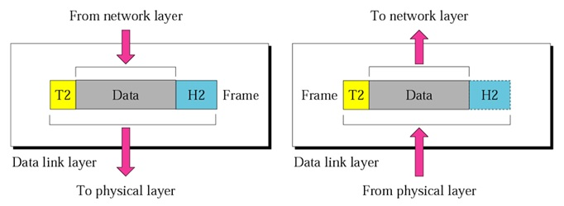
INTRODUCTION
The Data Link Layer (DLL) is second layer in OSI reference model
It receives services from the physical layer and provides services to the network layer
It is responsible for moving data (frames) from one node to another node

Slide 6
Design issues for dll (or) services provided by dll
Framing:
The data link layer needs to pack bits into frames, so that each frame is distinguishable from another
A frame is the encapsulation of the header and trailer information with the packet
Physical Addressing:
In the header, the source and destination MAC address are dealt
Flow Control:
The Flow control in data link layer is end to end flow control
Provides speed matching mechanism between the fast sender and slow receiver
Flow control coordinates the amount of the data that can be send before receiving an acknowledgement

Slide 7
Design issues for dll (or) services provided by dll
Error Control:
The DLL is responsible for error free transmission of frame from source (node) to destination( node)
Error control is achieved by adding a trailer at the end of the frame (Error detection or Error Correction)
Access Control:
It is responsible for allocation of channel for multiple devices

Slide 8
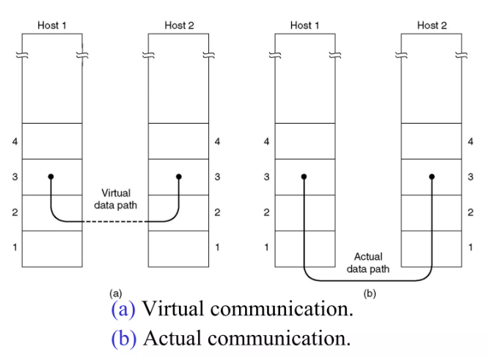
Services Provided to the Network Layer
The function of the data link layer is to provide services to the network layer.
The principal service is transferring data from the network layer on the source machine to the network layer on the destination machine.
The data link layer can be designed to offer various services.
The actual services that are offered vary from protocol to protocol.
The main three reasonable possibilities are
1. Unacknowledged connectionless service
2. Acknowledged connectionless service.
3. Acknowledged connection-oriented service.

Slide 9
Services Provided to the Network Layer
Unacknowledged connectionless service
Unacknowledged connectionless service consists of having the source machine send independent frames to the destination machine without having the destination machine acknowledge them
Acknowledged connectionless service
In this type of services there are still no logical connections used, but each frame sent is individually acknowledged.
In this way, the sender knows whether a frame has arrived correctly or been lost
Acknowledged connection-oriented service
In this service the source and destination machines establish a connection before any data are transferred.
Each frame sent over the connection is numbered, and the data link layer guarantees that each frame sent is indeed received.
It guarantees that each frame is received exactly once and that all frames are received in the right order

Slide 10
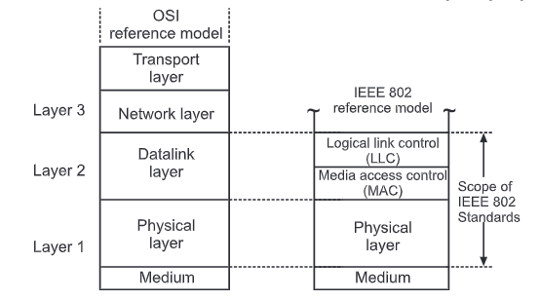
Data link sublayers
The Data Link Layer consists of two sublayers
Logical Link Control (LLC)
Media Access Control (MAC)
LOGICAL LINK CONTROL SUB LAYER
Handles communication between upper and lower layers
Takes the network protocol data and adds control information to help deliver the packet to the destination (Flow Control)

Slide 11
Media access control (MAC) sub layer
Constitutes the lower sublayer of the data link layer
Implemented by hardware, typically in the computer NIC
Two primary responsibilities
Data encapsulation
Media access control
DATA ENCAPSULATION
Frame assembly before transmission and frame disassembly upon reception of a frame (Framing)
Adds a header and trailer to the network layer packets (Physical Addressing and Error control)
MEDIA ACCESS CONTROL
It is responsible for the placement of frames on the media and the removal of frames from the media
It communicates directly with the physical layer

Slide 12
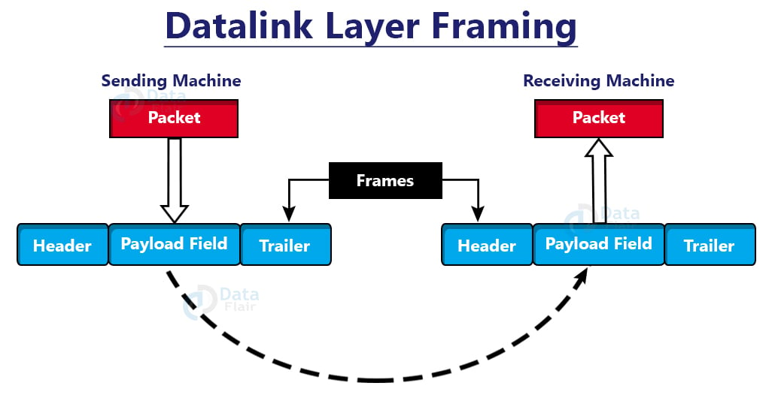
Framing
The data-link layer encapsulates packets from the network layer into frames by adding and header and trailer.
Then, on the hardware, it delivers each frame bit by bit.
The data connection layer at the receiver’s end collects signals from hardware and assembles them into frames.

Slide 13
framing
How can frame be transmitted so the receiver can detect frame boundaries?
That is, how can receiver recognize the start and end of a frame?
A good design must make it easy for a receiver to find the start of new frames while using little of the channel bandwidth.
There four methods are used :
Byte count
Flag bytes with byte stuffing
Flag bits with bit stuffing
Physical layer coding violations

Slide 14
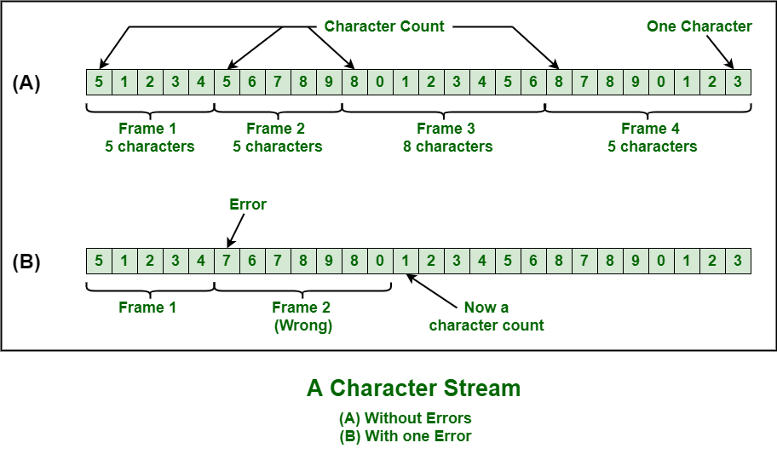
Framing – character/byte count
The first framing method uses a field in the header to specify the number of bytes in the frame.
When the data link layer at the destination sees the byte count, it knows how many bytes follow and hence where the end of the frame is.
The protocol used in the Data link layer for this type framing is DDCMP (Digital Data Communication Message Protocol)

Slide 15
Framing – character/byte count
PROBLEM WITH THIS METHOD
There is disadvantage also of using this method i.e., if any one character count is disturbed or distorted by an error occurring during transmission, then destination or receiver might lose synchronization.
The destination or receiver might also be not able to locate or identify beginning of next frame.

Slide 16
framing – flag bytes with byte stuffing
Here each frame is viewed as collection of bytes (characters) rather than bits
Also called as character oriented approach
There are two protocols in data link layer that uses this format each frame start and end with special bytes.
Often the same byte, called a flag byte, is used as both the starting and ending delimiter
BISYNC (Binary Synchronous Communication Protocol
PPP (Point to Point Protocol)

Slide 17
framing – flag bytes with byte stuffing
In the BISYNC protocol frame format uses reserved characters to indicate the start and end of a frame.
Use the two character sequence DLE STX (Data Link Escape, Start of Text) to indicated the beginning of frame
The sequence DLE ETX (Data Link Escape End of Text) to flag the frame’s end
The problem occurs when these character patterns occur within the “transparent” data.
Solution: sender stuffs an extra DLE into the data stream just before each occurrence of an “accidental” DLE in the data stream.
The data link layer on the receiving end unstuffs the DLE before giving the data to the network layer.
This stuffing process is called Byte or Character stuffing

Slide 18
Byte stuffing or character stuffing
Byte stuffing or character stuffing is the process of adding one extra byte or character whenever there is a flag or escape character in the transparent text or data.
DLE
STX
Transparent Data
DLE
ETX
Before
DLE
STX
A
B
DLE
H
W
DLE
ETX
Stuffed
DLE
STX
A
B
DLE
DLE
H
W
DLE
ETX
Unstuffed
DLE
STX
A
B
DLE
H
W
DLE
ETX

Slide 19
framing – flag bytes with byte stuffing
In the PPP protocol frame format uses FLAG BYTE to indicate the start and end of a frame.
Two consecutive flag bytes indicate the end of one frame and the start of the next
It may happen that the flag byte occurs in the data,
One way to solve this problem is to have the sender’s data link layer insert a special escape byte (ESC) just before each ‘‘accidental’’ flag byte in the data.
Thus, a framing flag byte can be distinguished from one in the data by the absence or presence of an escape byte before it.
The data link layer on the receiving end removes the escape bytes before giving the data to the network layer. This technique is called byte stuffing.

Slide 20
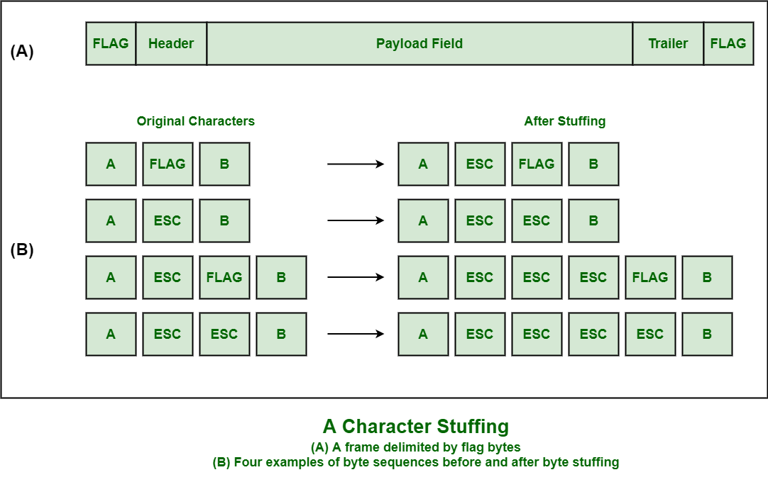
Byte stuffing or character stuffing

Slide 21
Framing- flag bits with bit stuffing
A disadvantage of byte stuffing, which is that it is tied to the use of 8-bit bytes.
Framing can be also be done at the bit level, so frames can contain an arbitrary number of bits
It was developed for the once very popular HDLC (High level Data Link Control) protocol.
Each frame begins and ends with a special bit pattern, 01111110 or 0x7E in hexadecimal. This pattern is a flag byte.
The problem occurs when these flag bits occur within the “transparent” data.
Solution: Whenever sender data link layer encounters five consecutive ones in the data stream, it automatically stuffs a 0 bit into the outgoing stream. This is called Bit Stuffing
When the receiver sees five consecutive incoming ones followed by a 0 bit, it automatically destuffs the 0 bit before sending the data to the network layer.

Slide 22
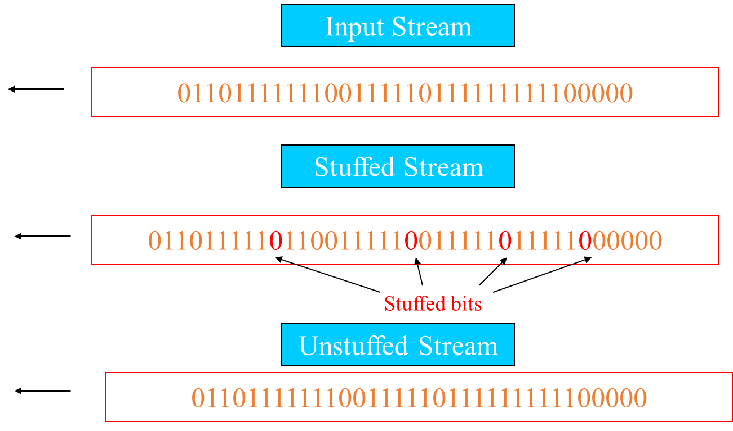
Bit stuffing

Slide 23
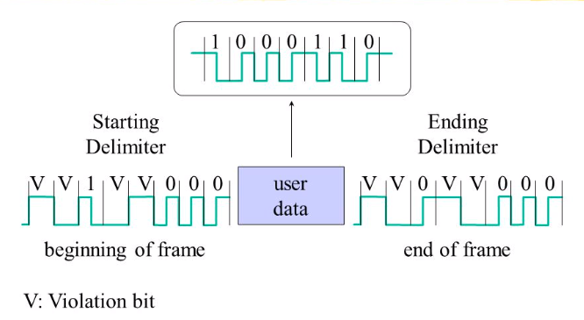
Physical layer coding violations
Encoding violation is a technique that is used just for framing in computer networks within which encoding on physical medium brings about some kind of repetition which is used in quite more than one graphical or visual structure to easily encode or represent one variable of information.

Slide 24
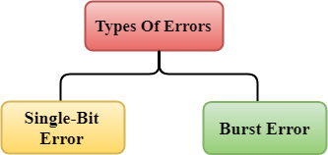
Error Detection and correction
When data is transmitted from one device to another device, the system does not guarantee whether the data received by the device is identical to the data transmitted by another device.
An Error is a situation when the message received at the receiver end is not identical to the message transmitted.
Errors can be classified into two categories:
Single bit error
Burst Error

Slide 25
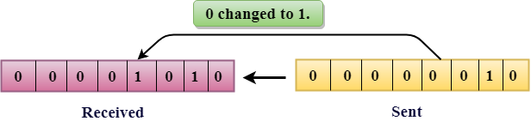
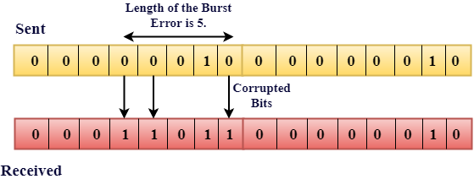
Types Of Errors
Single-Bit Error:
The only one bit of a given data unit is changed from 1 to 0 or from 0 to 1.
Burst Error:
The two or more bits are changed from 0 to 1 or from 1 to 0 is known as Burst Error.
The Burst Error is determined from the first corrupted bit to the last corrupted bit.

Slide 26
Error Detecting Techniques
Basic approach used for error detection is the use of redundancy, where additional bits are added to the data to detect the errors.
The most popular Error Detecting Techniques are:
Single parity check
Two-dimensional parity check
Checksum
Cyclic redundancy check

Slide 27
Single parity check
The simplest technique for detecting errors is to add an extra bit known as Parity bit to each word being transmitted.
There are two types of parity EVEN and ODD parity
EVEN Parity Check: If the number of 1s bits is odd, then parity bit 1 is appended and if the number of 1s bits is even, then parity bit 0 is appended at the end of the data unit.
ODD Parity Check: If the number of 1s bits is odd, then parity bit 0 is appended and if the number of 1s bits is even, then parity bit 1 is appended at the end of the data unit.
At the receiving end, the parity bit is calculated from the received data bits and compared with the received parity bit.

Slide 28
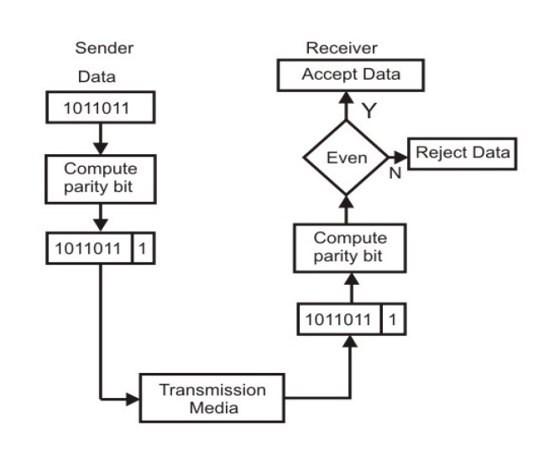
Single bit parity check

Slide 29
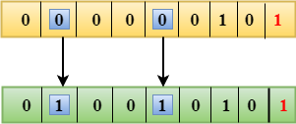
Single parity check
Drawbacks Of Single Parity Checking
It can only detect single-bit errors which are very rare.
If two bits are interchanged, then it cannot detect the errors

Slide 30
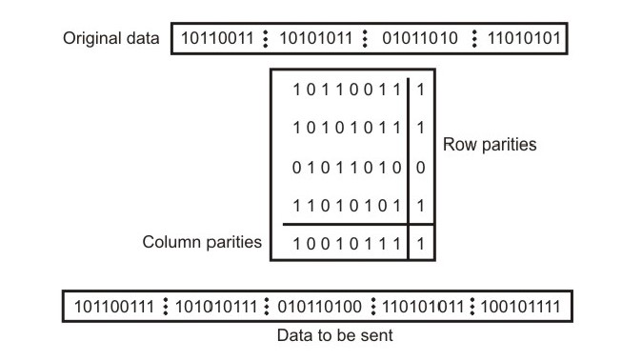
Two-Dimensional Parity Check
Performance can be improved by using two-dimensional parity check, which organizes the block of bits in the form of a table.
Parity check bits are calculated for each row, which is equivalent to a simple parity check bit.
Parity check bits are also calculated for all columns then both are sent along with the data.
At the receiving end these are compared with the parity bits calculated on the received data.

Slide 31
Two-Dimensional Parity Check
DISADVANTAGES
If two bits in one data unit are damaged and two bits in exactly same position in another data unit are also damaged, the 2-D Parity check checker will not detect an error.

Slide 32
Check sum
A Checksum is an error detection technique based on the concept of redundancy.
In checksum error detection scheme, the data is divided into k segments each of m bits.
In the sender’s end the segments are added using 1’s complement arithmetic to get the sum.
The sum is complemented to get the checksum.
The checksum segment is sent along with the data segments.
At the receiver’s end, all received segments are added using 1’s complement arithmetic to get the sum.
The sum is complemented. If the result is zero, the received data is accepted; otherwise discarded.

Slide 33
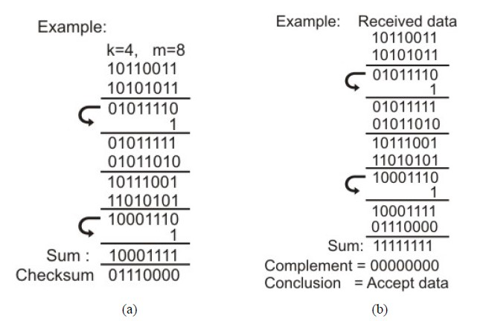
Check sum
(a) Sender’s end for the calculation of the checksum, (b) Receiving end for checking the checksum

Slide 34
Cyclic Redundancy Check (CRC)
CRC is based on binary division
In CRC, a sequence of redundant bits, called cyclic redundancy check bits, are appended to the end of data unit so that the resulting data unit becomes exactly divisible by a second, predetermined binary number.
At the destination, the incoming data unit is divided by the same number.
If at this step there is no remainder, the data unit is assumed to be correct and is therefore accepted.
A remainder indicates that the data unit has been damaged in transit and therefore must be rejected.

Slide 35
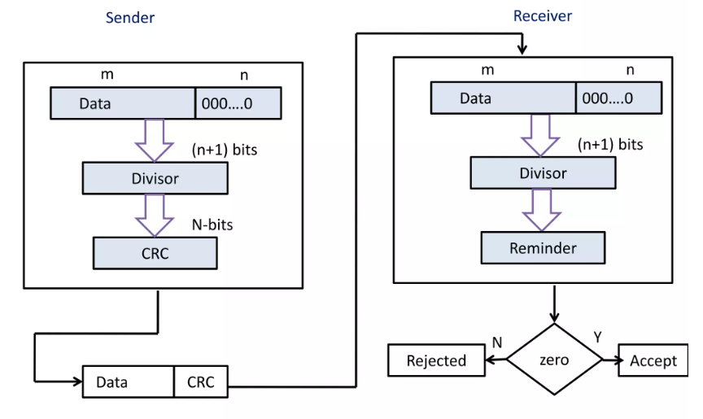
CRC

Slide 36
CRC GENERATOR
Step 1: Append a string of n 0s to the data (Message M) unit where n is 1 less than the number of bits in the generator polynomial G(x) (divisor with n+1 bits long)
Step 2: Divide the modified data unit by the divisor. This is a binary division
Step 3: The remainder obtained after division is the n bit CRC bits
Step 4: The CRC will replace the n 0s append to the data unit to get the code word to be transmitted

Slide 37
CRC Checker
The data received at the receiver consists of data and CRC.
The receiver treats it as one unit and divides it by the same (n+1) bits generator polynomial divisor which was used at the transmitter.
The remainder of the division is then checked
If the remainder is zero, then the received codeword is error free and hence should be accepted
A non zero remainder indicates presence of errors and hence the corresponding codeword should be rejected.

Slide 38
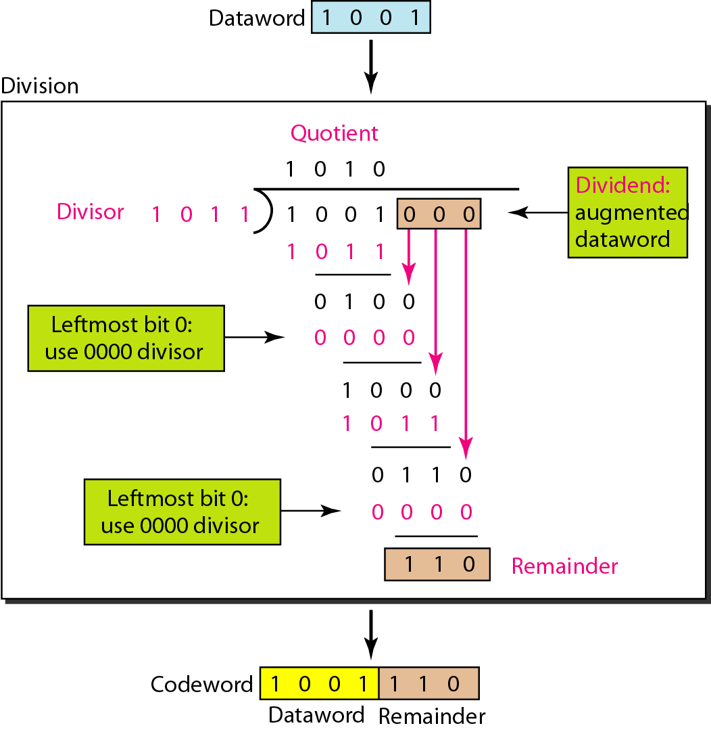
CRC GENERATOR

Slide 39
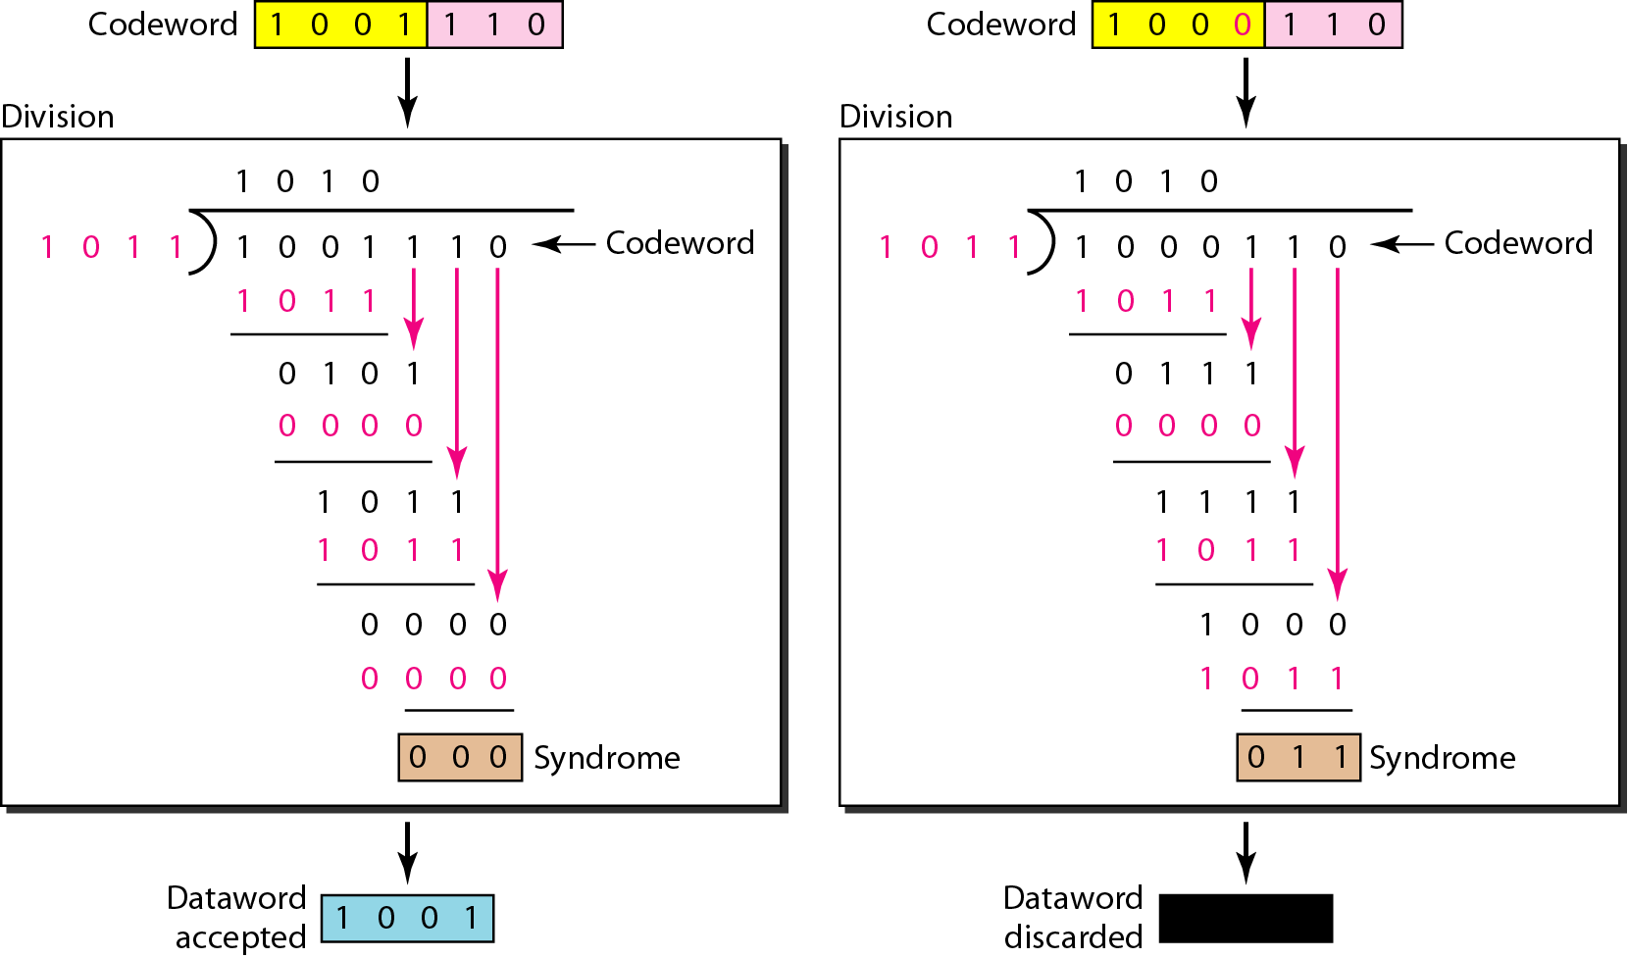
CRC CHECKER

Slide 40
Internationally used CRC polynomials
CRC 12 : x12 + x11 + x3 + x2 + x + 1
CRC 16 : x16 + x15 + x2 + 1
CRC CCITT : x16 + x12 + x5 + 1
CRC-CCITT (Cyclic Redundancy Check - Consultative Committee for International Telephony and Telegraphy)

Slide 41
Error correction
Error Correction codes are used to detect and correct the errors when data is transmitted from the sender to the receiver.
Error Correction can be handled in two ways:
Backward error correction: Once the error is discovered, the receiver requests the sender to retransmit the entire data unit.
Forward error correction: In this case, the receiver uses the error-correcting code which automatically corrects the errors.

Slide 42
Error correction
A single additional bit can detect the error, but cannot correct it.
For correcting the errors, one has to know the exact position of the error.
For example, If we want to calculate a single-bit error, the error correction code will determine which one of seven bits is in error.
To achieve this, we have to add some additional redundant bits.
Suppose r is the number of redundant bits and d is the total number of the data bits. The number of redundant bits r can be calculated by using the formula:
2^{r}>=d+r+1

Slide 43
Hamming code
To determine the position of the bit which is in error, a technique developed by R.W Hamming is Hamming code
Which can be applied to any length of the data unit and uses the relationship between data units and redundant units.

Slide 44
Algorithm of Hamming code
An information of 'd' bits are added to the redundant bits 'r' to form d+r.
The location of each of the (d+r) digits is assigned a decimal value.
The 'r' bits are placed in the positions 1,2,.....2k-1.
At the receiving end, the parity bits are recalculated. The decimal value of the parity bits determines the position of an error.
7 | 6 | 5 | 4 | 3 | 2 | 1
d | d | d | r4 | d | r2 | r1

Slide 45
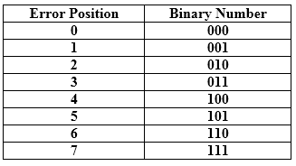
Relationship b/w Error position & binary number.
Let's understand the concept of Hamming code through an example:
Suppose the original data is 1010 which is to be sent.
Total number of data bits 'd' = 4
Number of redundant bits r : 2r >= d+r+1
2^{r}>= 4+r+1
Therefore, the value of r is 3 that satisfies the above relation.
Total number of bits = d+r = 4+3 = 7;

Slide 46
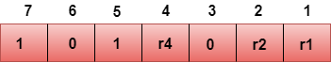
Determining the position of the redundant bits
The number of redundant bits is 3. The three bits are represented by r1, r2, r4. The position of the redundant bits is calculated with corresponds to the raised power of 2. Therefore, their corresponding positions are 1, 2¹, 2².
Representation of Data on the addition of parity bits:

Slide 47
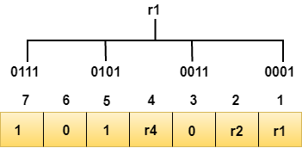
Determining the Parity bits
Determining the r1 bit
The r1 bit is calculated by performing a parity check on the bit positions whose binary representation includes 1 in the first position.
We observe from the above figure that the bit positions that includes 1 in the first position are 1, 3, 5, 7.
Now, we perform the even-parity check at these bit positions.
The total number of 1 at these bit positions corresponding to r1 is even, therefore, the value of the r1 bit is 0.

Slide 48
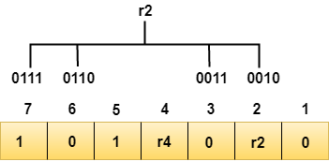
Determining the Parity bits
Determining r2 bit
The r2 bit is calculated by performing a parity check on the bit positions whose binary representation includes 1 in the second position.
We observe from the above figure that the bit positions that includes 1 in the second position are 2, 3, 6, 7.
Now, we perform the even-parity check at these bit positions.
The total number of 1 at these bit positions corresponding to r2 is odd, therefore, the value of the r2 bit is 1.

Slide 49
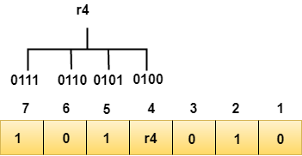
Determining the Parity bits
Determining r4 bit
The r4 bit is calculated by performing a parity check on the bit positions whose binary representation includes 1 in the third position.
We observe from the above figure that the bit positions that includes 1 in the third position are 4, 5, 6, 7.
Now, we perform the even-parity check at these bit positions.
The total number of 1 at these bit positions corresponding to r4 is even, therefore, the value of the r4 bit is 0.

Slide 50
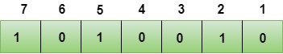
Data transferred is given below
Suppose the 4th bit is changed from 0 to 1 at the receiving end, then parity bits are recalculated.

Slide 51
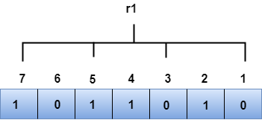
R1 bit
The bit positions of the r1 bit are 1,3,5,7
We observe from the above figure that the binary representation of r1 is 1100.
Now, we perform the even-parity check, the total number of 1s appearing in the r1 bit is an even number.
Therefore, the value of r1 is 0.

Slide 52
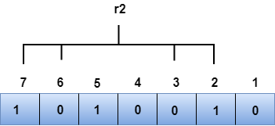
R2 bit
The bit positions of r2 bit are 2,3,6,7.
We observe from the above figure that the binary representation of r2 is 1001.
Now, we perform the even-parity check, the total number of 1s appearing in the r2 bit is an even number.
Therefore, the value of r2 is 0.

Slide 53
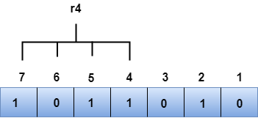
R4 bit
The bit positions of r4 bit are 4,5,6,7.
We observe from the above figure that the binary representation of r4 is 1011.
Now, we perform the even-parity check, the total number of 1s appearing in the r4 bit is an odd number.
Therefore, the value of r4 is 1.

Slide 54
Error correction using hamming code
The binary representation of redundant bits, i.e., r4r2r1 is 100, and its corresponding decimal value is 4.
Therefore, the error occurs in a 4th bit position.
The bit value must be changed from 1 to 0 to correct the error.

Slide 55
Error detection using hamming code
Hamming distance is a metric for comparing two binary data strings.
While comparing two binary strings of equal length, Hamming distance is the number of bit positions in which the two bits are different.
The Hamming distance between two strings, a and b is denoted as d(a,b).
It is used for error detection or error correction when data is transmitted over computer networks.

Slide 56
Calculation of Hamming Distance
In order to calculate the Hamming distance between two strings, and , we perform their XOR operation, (a⊕ b), and then count the total number of 1s in the resultant string.
Example
Suppose there are two strings 1101 1001 and 1001 1101.
11011001 ⊕ 10011101 = 01000100. Since, this contains two 1s, the Hamming distance, d(11011001, 10011101) = 2.

Slide 57
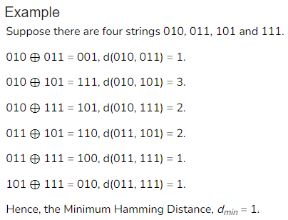
Minimum Hamming Distance
In a set of strings of equal lengths, the minimum Hamming distance is the smallest Hamming distance between all possible pairs of strings in that set.

Slide 58
Elementary data link protocols
Protocols in the data link layer are designed so that this layer can perform its basic functions: framing, error control and flow control.
Framing is the process of dividing bit - streams from physical layer into data frames whose size ranges from a few hundred to a few thousand bytes.
Error control mechanisms deals with transmission errors and retransmission of corrupted and lost frames.
Flow control regulates speed of delivery and so that a fast sender does not drown a slow receiver.

Slide 59
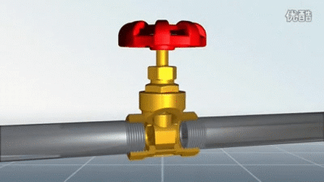
Flow Control
Flow Control is an essential function of the data link layer.
It determines the amount of data that a sender can send.
It makes the sender wait until an acknowledgment is received from the receiver’s end.
Methods of Flow Control are Stop-and-wait , and Sliding window.

Slide 60
Purpose of Flow Control
The device on the receiving end has a limited amount of memory (to store incoming data) and limited speed (to process incoming data). The receiver might get overwhelmed if the rate at which the sender sends data is faster or the amount of data sent is more than its capacity.
Buffers are blocks in the memory that store data until it is processed. If the buffer is overloaded and there is more incoming data, then the receiver will start losing frames.
The flow control mechanism was devised to avoid this loss and wastage of frames. Following this mechanism, the receiver, as per its capacity, sends an acknowledgment to send fewer frames or temporarily halt the transmission until it can receive again.
Thus, flow control is the method of controlling the rate of transmission of data to a value that the receiver can handle.

Slide 61
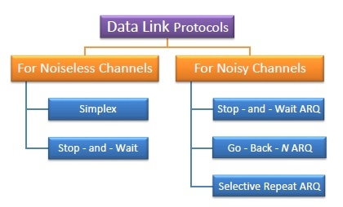
Types of Data Link Protocols
Data link protocols can be broadly divided into two categories, depending on whether the transmission channel is noiseless or noisy.

Slide 62
Unrestricted Simplex Protocol
Data transmitting is carried out in one direction only
The Transmission (Tx) and Receiving (Rx) are always ready
The processing time can be ignored ( Zero Processing time)
In this protocol, assumes infinite buffer space is available
No errors are occurring that is no damage frames and no lost frames.
All this is highly unrealistic. This protocol is also called as Utopia

Slide 63
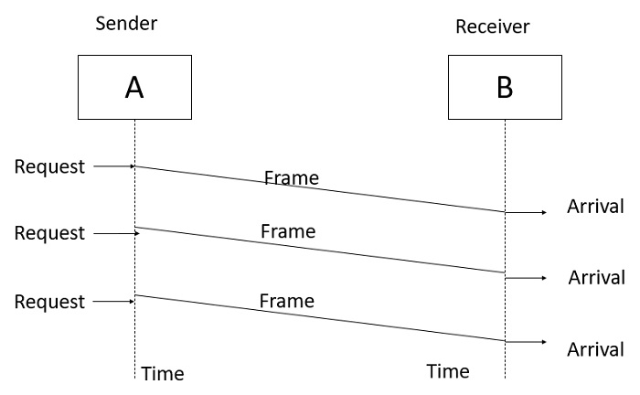
Unrestricted Simplex Protocol
The Unrestricted Simplex Protocol is diagrammatically represented as follows −

Slide 64
Simplex stop and wait protocol for error free channel
The most unrealistic restriction in the previous protocol is the assumption that receiving network layer can process the data with zero processing time.
In this protocol it is assumed that a finite processing time is essential
The communication channel is assumed to be noise free and the communication in only one direction at a time.
This protocol deals with the important problem i.e., flow control
how to prevent the sender from flooding the receiver with data faster than its processing speed

Slide 65
Simplex stop and wait protocol for error free channel
To control the flow of data a small dummy frame is sent back form the receiver to the transmitter to indicate that it can send the next frame.
The transmitter sends one frame and then waits for the dummy frame called acknowledgement.
Once the acknowledgement is received, it sends the next frame.
Hence, the name stop-and-wait protocol.

Slide 66
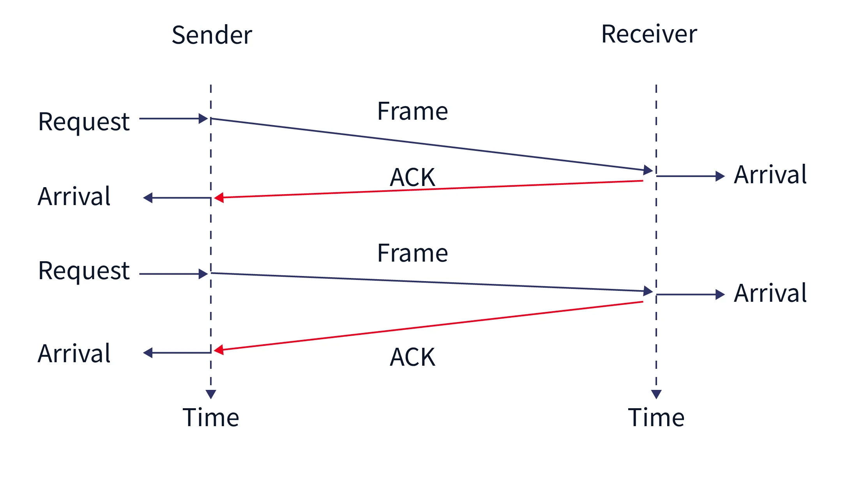
Simplex stop and wait protocol for error free channel

Slide 67
Noisy Channel
In computer networks, a noisy channel refers to a communication channel that has a high level of interference or distortion. This interference can lead to errors in the transmission of data, which can impact the performance and reliability of the network.
External Interference: Noise can be introduced into a channel due to external factors such as electromagnetic interference (EMI) from electronic devices, radio signals, power lines, and other sources of electromagnetic radiation.
Impulse Noise: It can be caused by various factors, such as power surges, lightning strikes, or faulty connections.
Atmospheric Conditions: In wireless communication, weather conditions, atmospheric interference, and geographical features can impact the quality of the transmitted signal, leading to noise.

Slide 68
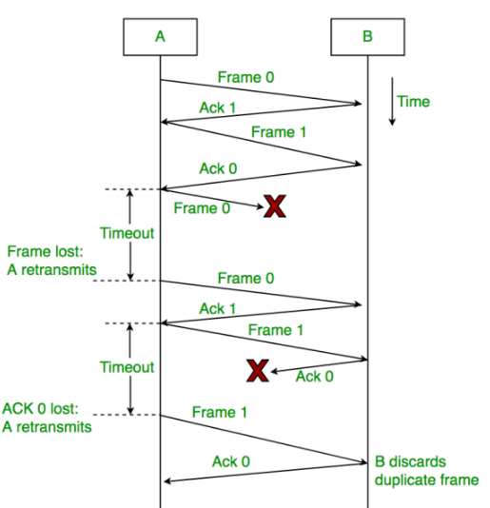
Simplex stop and wait protocol for error channel
Assume that the communication channel is noisy and can introduce errors in the data travelling over it.
Frames may either be damaged or lost completely.
In this protocol, the sender waits for a positive acknowledgement before advancing to the next data item.

Slide 69
Simplex stop and wait protocol for noisy channel
It is called as (Positive Acknowledgement with Retransmission) or ARQ (Automatic Repeat request)
Due to retransmission, there is always a possibility of duplication of frames at the receiver. To avoid this, the sender puts a sequence number in the leader of frame it sends.
The receiver can check the sequence number of each arriving frame to check the possible duplication.
If a frame is duplicated then receiver will discard it.
The operation can be divided into two modes:
Normal operation
Time out

Slide 71
UNIT II PART B SLIDING WINDOW PROTOCOLS

Slide 72
OUTLINE
What is sliding window protocol?
Sliding Window Protocols
A one-bit sliding window protocol (Stop-and- wait ARQ)
A protocol using Back-N ARQ
A protocol using Selective Repeat
Example data link protocols
ADSL
SONET
HDLC
PPP

Slide 73
SLIDING WINDOW PROTOCOL
The sliding window protocol is the flow control protocol for noisy channels that allows the sender to send multiple frames even before acknowledgments are received.
It is called a Sliding window because the sender slides its window upon receiving the acknowledgments for the sent frames.
All the sliding window protocols are bidirectional

Slide 74
WORKING
The sender and receiver have a “window” of frames. A window is a space that consists of multiple bytes. The size of the window on the receiver side is always 1.
Each frame is sequentially numbered from 0 to n - 1, where n is the window size at the sender side.
The sender sends as many frames as would fit in a window.
After receiving the desired number of frames, the receiver sends an acknowledgment. The acknowledgment (ACK) includes the number of the next expected frame.

Slide 75
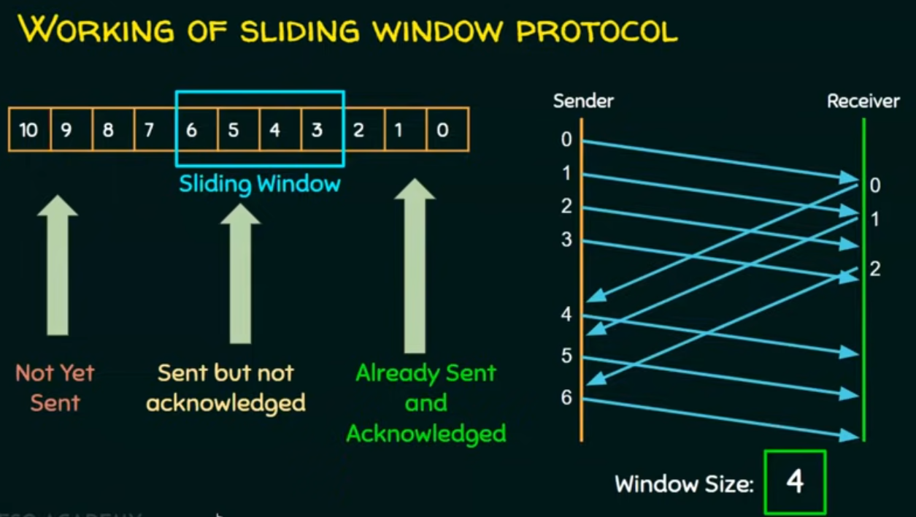

Slide 76

How To Increase Network Efficiency?
Efficiency can also be improved by making use of the Full-duplex transmission mode.
Full Duplex transmission is a two-way directional communication simultaneously which means that it can communicate in both directions, just like we are using two half-duplex transmission nodes.
It provides better performance than simple transmission modes and half-duplex transmission modes.

Slide 77
How To Increase Network Efficiency?
Another way it increase the network efficiency is
When data frame arrives, instead of immediately sending a separate control frame (Acknowledgement), the receiver restrains, itself and waits until the network layer passes it the next packet.
The acknowledgement is attached to the outgoing data frame (using the ack field in the frame header).
In effect, the acknowledgement gets a free ride on the next outgoing data frame.

Slide 78
Piggybacking
The technique of temporarily delaying outgoing acknowledgments so that they can be hooked onto the next outgoing data frame is known as piggybacking
Advantages:
The major advantage of piggybacking is better use of available channel bandwidth
Disadvantages:
Additional system complexity
If the data link layer waits too long before transmitting acknowledgement, then retransmission of frame will take place.

Slide 79
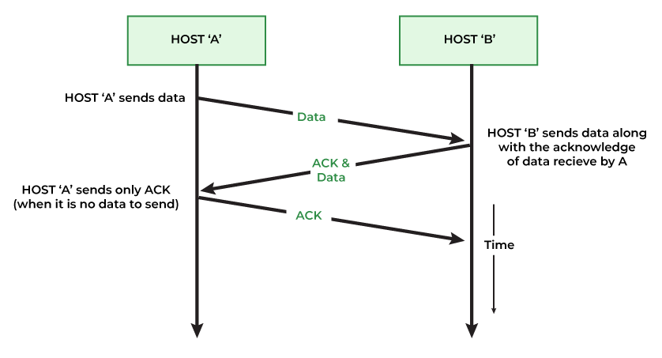
PIGGYBACKING

Slide 80
STOP AND WAIT AUTOMATIC REPEAT REQUEST
This is also called as 1-bit sliding window protocol.
The stop and wait ARQ protocol sends a data frame and then waits for an acknowledgment or ACK from the receiver.
The ACK means that the receiver has successfully received the data frame.
After the sender receives the ACK from the receiver, it sends the next data frame.
So, there is a wait and then the next data frame is transmitted so the name came Stop and Wait ARQ protocol.

Slide 81
STOP AND WAIT ARQ
In the stop and wait ARQ protocol, ARQ stands for Automatic Repeat Request.
ARQ is an error-control strategy that ensures that a sequence of information is delivered in order and without any error or duplications despite transmission errors and losses.
In the stop and wait ARQ, the sender also keeps a copy of the currently sending frame so that if the receiver does not receive the frame then it can retransmit it.
In stop and wait ARQ, the sender sets a timer for each frame so whenever the timer is over and the sender has not received any acknowledgment for the frame, then the sender knows that the particular frame is either lost or damaged.
So, the sender sends back the lost or damaged frame once the timer is out. So, we can see that the sender needs to wait for the timer to expire before retransmission

Slide 82
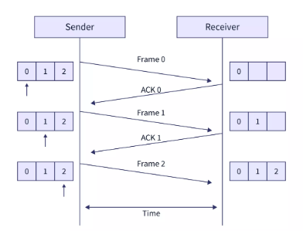
WORKING PRINCIPLE OF STOP AND WAIT ARQ
The steps of data transmission can be:
The sender sends frame 0.
The sender waits for ACK from the receiver.
The receiver receives the frame and sends back ACK 0.
Again the sender sends the frame 1 and this process is continued till all the frames have been received by the receiver.

Slide 83
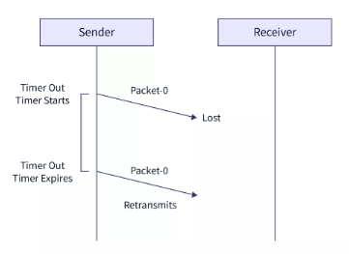
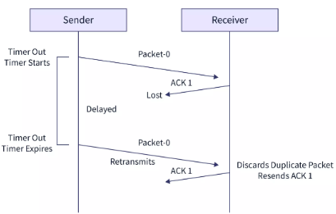
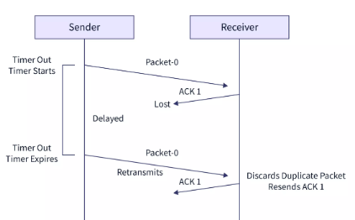
Various problems of the Stop and Wait ARQ
Problem of Lost Data Packet
Problem of Lost Acknowledgement
Problem of Delayed Acknowledgement

Slide 84
Limitations of Stop and Wait ARQ
Let us discuss some of the limitations or disadvantages of the stop and wait ARQ
The data can be lost in between the transmission. So, in such a case, the sender waits for ACK and the receiver waits for the data frame for an infinite amount of time.
The ACK from the receiver may get lost in the channel. So, the sender waits for ACK for an infinite amount of time.
The window size of the sender and the receiver is only 1. So, only one frame can be sent at a time.

Slide 85
GO-BACK-N ARQ
To deal with the retransmission of lost or damaged frames, a few changes are made to the sliding window mechanism used in flow control.
Multiple frames present in a single window are sent together from sender to receiver.
The size of the sender window in Go Back N ARQ is equal to N.
The size of the receiver window in Go Back N ARQ is equal to 1.
Data packets are divided into multiple frames. These multiple frames are numbered so that they can be distinguished from each other.

Slide 86
GO-BACK-N ARQ
The integer 'N' in Go Back 'N' ARQ tells us the size of the window i.e. the number of frames that are sent at once from sender to receiver.
Suppose the window size 'N' is equal to 4. Then, 4 frames (frame 0, frame 1, frame 2, and frame 3) will be sent first from sender to receiver.
Pipelining is allowed in the Go Back N ARQ protocol. Pipelining means sending a frame before receiving the acknowledgment for the previously sent frame.
If we have five frames and the concept is Go-Back-3, which means that the three frames can be sent, i.e., frame no 1, frame no 2, frame no 3 can be sent before expecting the acknowledgment of frame no 1.

Slide 87
GO-BACK-N ARQ
Receiver sends the acknowledgment of frame 1. Then the sliding window moves by one and frame 4 is sent.
The sender waits for the acknowledgment for some fixed amount of time.
If the sender does not get the acknowledgment for a frame in the time, it considers the frame to be corrupted.
Then the sliding window moves to the starting of the corrupted frame and all the frames in the window are retransmitted.

Slide 88
WORKING PRINCIPLE OF GO-BACK-N ARQ
Suppose there are a sender and a receiver, and let's assume that there are 11 frames to be sent.
These frames are represented as 0,1,2,3,4,5,6,7,8,9,10, and these are the sequence numbers of the frames.
Mainly, the sequence number is decided by the sender's window size.
But, for the better understanding, we took the running sequence numbers, i.e., 0,1,2,3,4,5,6,7,8,9,10.
Let's consider the window size as 4, which means that the four frames can be sent at a time before expecting the acknowledgment of the first frame.

Slide 89
WORKING PRINCIPLE OF GO-BACK-N ARQ
Firstly, the sender will send the first four frames to the receiver, i.e., 0,1,2,3, and now the sender is expected to receive the acknowledgment of the 0th frame.
Sender
Receiver
Sliding Window
0
10 | 9 | 8 | 7 | 6 | 5 | 4 | 3 | 2 | 1 | 0
1
2
3
Window Size:
4

Slide 90
WORKING PRINCIPLE OF GO-BACK-N ARQ
Let's assume that the receiver has sent the acknowledgment for the 0 frame, and the receiver has successfully received it
Sender
Receiver
Sliding Window
0
10 | 9 | 8 | 7 | 6 | 5 | 4 | 3 | 2 | 1 | 0
1
0
2
3
Window Size:
4

Slide 91
WORKING PRINCIPLE OF GO-BACK-N ARQ
The sender will then send the next frame, i.e., 4, and the window slides containing four frames (1,2,3,4)
Sender
Receiver
Sliding Window
0
10 | 9 | 8 | 7 | 6 | 5 | 4 | 3 | 2 | 1 | 0
1
0
2
3
Window Size:
4
4

Slide 92
WORKING PRINCIPLE OF GO-BACK-N ARQ
The receiver will then send the acknowledgment for the frame no 1. After receiving the acknowledgment, the sender will send the next frame, i.e., frame no 5, and the window will slide having four frames (2,3,4,5).
Sender
Receiver
Sliding Window
0
10 | 9 | 8 | 7 | 6 | 5 | 4 | 3 | 2 | 1 | 0
1
0
2
1
3
Window Size:
4
4
5

Slide 93
WORKING PRINCIPLE OF GO-BACK-N ARQ
Now, let's assume that the receiver is not acknowledging the frame no 2, either the frame is lost, or the acknowledgment is lost. Instead of sending the frame no 6, the sender Go-Back to 2, which is the first frame of the current window, retransmits all the frames in the current window, i.e., 2,3,4,5.
Sender
Receiver
Sliding Window
0
10 | 9 | 8 | 7 | 6 | 5 | 4 | 3 | 2 | 1 | 0
1
0
2
1
3
2
Window Size:
4
4
X
5

Slide 94
WORKING PRINCIPLE OF GO-BACK-N ARQ
Sender
Receiver
Sliding Window
0
10 | 9 | 8 | 7 | 6 | 5 | 4 | 3 | 2 | 1 | 0
1
0
2
1
3
2
Window Size:
4
4
X
It does not consider the corrupted frames and simply discards them.
It does not accept the frames which are out of order and discards them.
If the sender does not receive the acknowledgment, it leads to the retransmission of all the current window frames.
5
2
3
4
5

Slide 95
SELECTIVE REPEAT ARQ
The go-back-n protocol works well if errors are less, but if the line is poor it wastes a lot of bandwidth on retransmitted frames.
An alternative strategy, the selective repeat protocol, is to allow the receiver to accept and buffer the frames following a damaged or lost one.
Selective Repeat attempts to retransmit only those packets that are actually lost (due to errors)

Slide 96
SELECTIVE REPEAT ARQ
If any frame is lost or damaged then the receiver sends a negative acknowledgment (NACK) to the sender and if the frame is correctly received, it sends back an acknowledgment (ACK).
As we only resend the selected damaged frames so we name this technique the Selective Repeat ARQ technique.
The ACK and the NACK have the sequence number of the frame that helps the sender to identify the lost frame.

Slide 97
Working of Selective Repeat ARQ Protocol
In the selective repeat ARQ, both the sender and the receiver have windows of the same size.
The window on the sender's side covers the sequence of data packets that are sent (or to be sent).
On the other hand, the window on the receiver's side covers the sequence of data packets that are received (or to be received).
The size of the sender's window is 2^(m-1), where m is the number of bits used in the header of the packet to express the packet's sequence number.
The window size of the receiver is the same as that of the sender i.e. 2^(m-1).

Slide 98
Working of Selective Repeat ARQ Protocol
Sender
Receiver
Sliding Window
0
10 | 9 | 8 | 7 | 6 | 5 | 4 | 3 | 2 | 1 | 0
1
0
2
1
3
2
Window Size:
4
3
4
X
5
4
2
6

Slide 99
Selective Repeat ARQ Protocol
Disadvantages
As the receiver may receive the frames in a different order, the receiver has the capability of sorting the frames present in the memory buffer using the sequence numbers.
On the other hand, the sender must be capable enough to search for the lost frame for which the NACK has been received.
So searching at the sender's end and sorting at the receiver's are two minor drawbacks of the selective repeat ARQ.

Slide 101
UNIT III PART C MEDIUM ACCESS SUB LAYER

Slide 102
OUTLINE
The channel allocation problem
Static Channel Allocation
Dynamic Channel Allocation
Multiple access protocols
ALOHA
Carrier sense multiple access protocols
Collision free protocols
Wireless LANs
Data link layer switching

Slide 103
INTRODUCTION
The networks can be divided into three categories based on the transmission of the data as point-to-point, Multicast and Broadcast Network.
In this topic we discuss about the broadcast networks and their protocols.
The broadcast channels are also called as multi-access channels or random access channels.
In the broadcast networks, the most important points is the criteria to determine who is allowed to use the channel when more than one users want to use it.
A Protocol is used to make this decision
Such protocol, belongs to sublayer of data link layer called MAC (Medium Access Control) sublayer

Slide 104
MAC SUB LAYER
FUNCTIONS
To perform the control of access to media (Access Control)
It performs the unique addressing to stations directly connected to LAN (Physical Addressing)
Detection of Errors (Error Control)
The MAC sublayer coordinates the data link tasks within a specific LAN

Slide 105
What is Channel?
The channel might be a portion of the wireless spectrum in a geographic region, or a single wire or optical fiber to which multiple nodes are connected.
It does not matter what is the type of channel.
In both cases, the channel connects each user to all other users and any user who makes full use of the channel interferes with other users who also wish to use the channel.

Slide 106
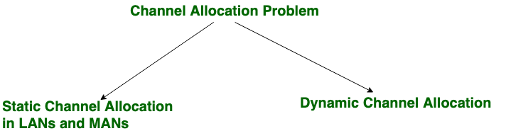
What is Channel Allocation?
In a broadcast network, the single broadcast channel is to be allocated to one transmitting user at a time. This is called as Channel Allocation
Channel allocation problem can be solved by two schemes: Static Channel Allocation , and Dynamic Channel Allocation.

Slide 107
STATIC CHANNEL ALLOCATION
It is the classical or traditional approach of allocating a single channel among multiple competing users using one of the multiplexing scheme such as Frequency Division Multiplexing (FDM).
If there are N users, the frequency channel is divided into N equal sized portions (bandwidth), each user being assigned one portion.
Since each user has a private frequency band, there is no interference between users.
When there is only a small and constant number of users, each of which has a steady stream or a heavy load of traffic, this division is a simple and efficient allocation mechanism.

Slide 108
STATIC CHANNEL ALLOCATION
DISADVANTAGE
The problem in these methods is that if all the N number of users are not using the channel the channel bandwidth is wasted and if there are more than N users who want to use the channel they cannot do so for the lack of bandwidth.
The static channel allocation has a poor performance with bursty traffic and hence generally dynamic channel allocation is used.

Slide 109
DYNAMIC CHANNEL ALLOCATION
In dynamic channel allocation no fixed frequency or fixed time slot is allotted to the user.
The user can use the single channel as per his requirement

Slide 110
DYNAMIC CHANNEL ALLOCATION
Following assumptions are made for the implementation of dynamic channel allocation
1. Independent Traffic
The model consists of N independent stations (e.g., computers, telephones), each with a program or user that generates frames for transmission.
Once a frame has been generated, the station is blocked and does nothing until the frame has been successfully transmitted.

Slide 111
DYNAMIC CHANNEL ALLOCATION
2. Single Channel
A single channel is available for all communication.
All stations can transmit on it and all can receive from it.
The stations are assumed to be equally capable, though protocols may assign them different roles (e.g., priorities).
3. Observable Collisions
If two frames are transmitted simultaneously, they overlap in time and the resulting signal is garbled. This event is called a collision.
All stations can detect that a collision has occurred.
A collided frame must be transmitted again later.
No errors other than those generated by collisions occur.

Slide 112
DYNAMIC CHANNEL ALLOCATION
4. Continuous or Slotted Time
Time may be assumed continuous, in which case frame transmission can begin at any instant.
Alternatively, time may be slotted or divided into discrete intervals (called slots).
Frame transmissions must then begin at the start of a slot.
5. Carrier Sense or No Carrier Sense.
With the carrier sense assumption, stations can tell if the channel is in use before trying to use it.
No station will attempt to use the channel while it is sensed as busy.
If there is no carrier sense, stations cannot sense the channel before trying to use it. They just go ahead and transmit.

Slide 113
Why Multiple Access Protocols?
When a S&R have a dedicated link to transmit data packets, the data link control is enough to handle the channel.
Suppose there is no dedicated path to communicate or transfer the data between two devices.
In that case, multiple stations access the channel and simultaneously transmits the data over the channel.
It may create collision and cross talk.
Hence, the multiple access protocol is required to reduce the collision and avoid crosstalk between the channels.

Slide 114
EXAMPLE
Suppose that there is a classroom full of students.
When a teacher asks a question, all the students (small channels) in the class start answering the question at the same time (transferring the data simultaneously).
All the students respond at the same time due to which data is overlap or data lost. Therefore it is the responsibility of a teacher (multiple access protocol) to manage the students and make them one answer.

Slide 115
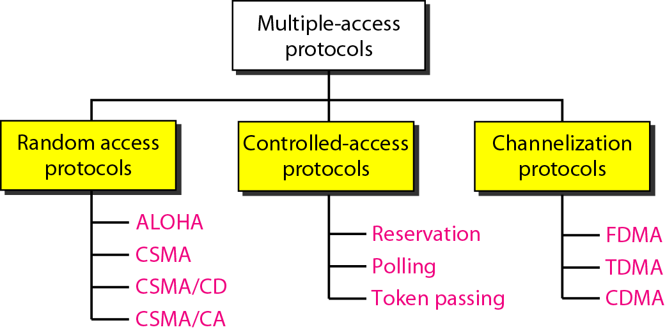
TYPES

Slide 116
RANDOM ACCESS PROTOCOL
In random-access or contention methods,
No station is superior to another station and none is assigned control over another.
At each instance, a station that has data to send uses a procedure defined by the protocol to make a decision on whether or not to send.
This decision depends on the state of the medium (idle or busy).
In other words, each station can transmit when it desires on the condition that it follows the predefined procedure, including testing the state of the medium.

Slide 117
RANDOM ACCESS PROTOCOL
Two features give this method its name.
First, there is no scheduled time for a station to transmit. Transmission is random among the stations.
That is why these methods are called random access.
Second, no rules specify which station should send next. Stations compete with one another to access the medium.
That is why these methods are also called contention methods.

Slide 118
RANDOM ACCESS PROTOCOL
The random-access methods have evolved from a very interesting protocol known as ALOHA (Advocates of Linux Open-source Hawaii Association), which used a very simple procedure called multiple access (MA).
The method was improved with the addition of a procedure that forces the station to sense the medium before transmitting. This was called carrier sense multiple access (CSMA).
This method later evolved into two parallel methods:
Carrier Sense Multiple Access with Collision Detection (CSMA/CD), which tells the station what to do when a collision is detected, and
Carrier Sense Multiple Access with Collision Avoidance (CSMA/CA), which tries to avoid the collision.

Slide 119
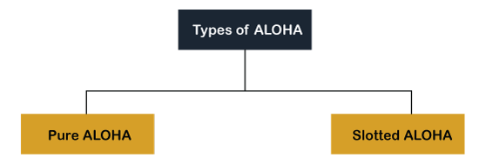
ALOHA
It is designed for wireless LAN (Local Area Network) but can also be used in a shared medium to transmit data.
Using this method, any station can transmit data across a network simultaneously when a data frameset is available for transmission.

Slide 120
ALOHA
RULES
Any station can transmit data to a channel at any time.
It does not require any carrier sensing.
Data frames may be lost during the transmission of data through multiple stations.
Acknowledgment of the frames exists in Aloha. Hence, there is no collision detection.
It requires retransmission of data after some random amount of time.

Slide 121
PURE ALOHA
The original ALOHA protocol is called pure ALOHA
Each station sends a frame whenever it has a frame to send (multiple access).
When each station transmits data to a channel without checking whether the channel is idle or not, there is a chance for collision may occur, and the data frame can be lost.
When any station transmits the data frame to a channel, the pure Aloha waits for the receiver's acknowledgment.
If it does not acknowledge the receiver end within the specified time, the station waits for a random amount of time, called the back off time (Tb).
And the station may assume the frame has been lost or destroyed. Therefore, it retransmits the frame until all the data are successfully transmitted to the receiver.

Slide 122
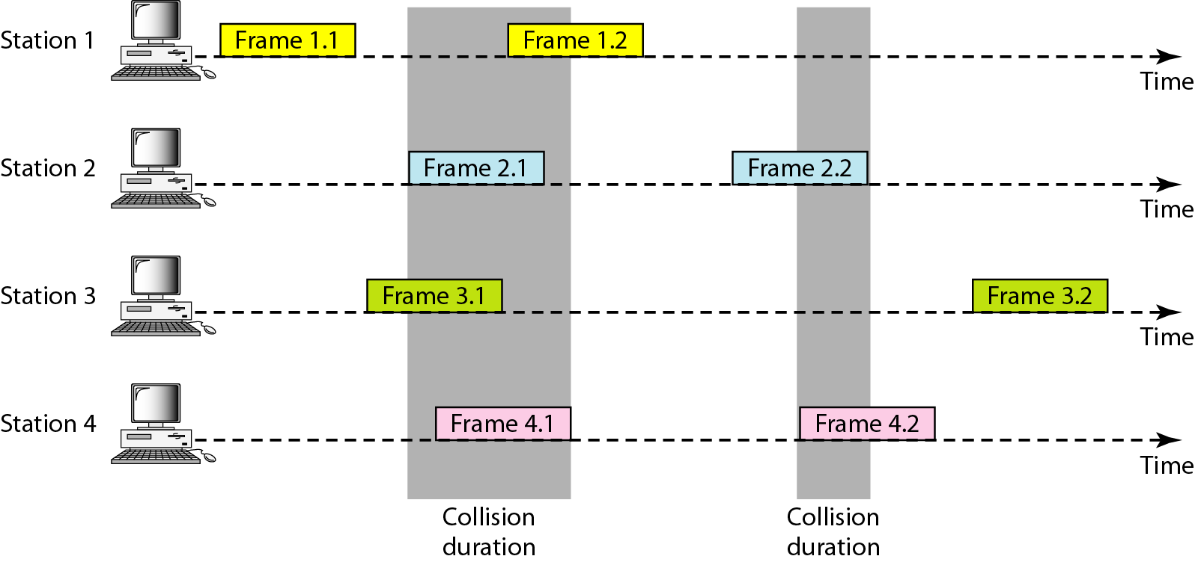
FRAMES IN A PURE ALOHA NETWORK

Slide 123
PURE ALOHA
As we can see in the figure above, there are four stations for accessing a shared channel and transmitting data frames.
Some frames collide because most stations send their frames at the same time.
Only two frames, frame 1.1 and frame 3.2, are successfully transmitted to the receiver end.
At the same time, other frames are lost or destroyed.
Whenever two frames fall on a shared channel simultaneously, collisions can occur, and both will suffer damage.
Even if one bit of a frame coexists on the channel with one bit from another frame, there is a collision and both will be destroyed.
It is obvious that we need to resend the frames that have been destroyed during transmission.

Slide 124
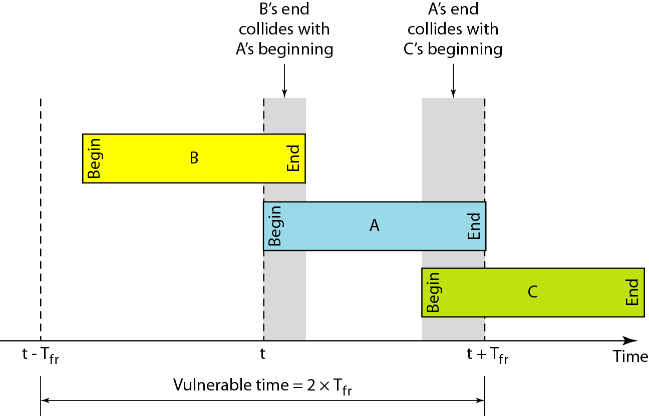
Vulnerable time for pure ALOHA protocol
The vulnerable time, is the length of time in which there is a possibility of collision. We assume that the stations send fixed-length frames with each frame taking T_{fr} seconds to send. Figure shows the vulnerable time for station B.

Slide 125
SLOTTED ALOHA
The slotted Aloha is designed to overcome the pure Aloha's deficiency because pure Aloha has a very high possibility of frame hitting.
In slotted Aloha, the shared channel is divided into a fixed time interval called slots.
If a station wants to send a frame to a shared channel, the frame can only be sent at the beginning of the slot, and only one frame is allowed to be sent in each slot.

Slide 126
SLOTTED ALOHA
If the stations are unable to send data to the beginning of the slot, the station will have to wait until the beginning of the slot for the next time.
However, the possibility of a collision remains when trying to send a frame at the beginning of two or more station time slot.

Slide 127
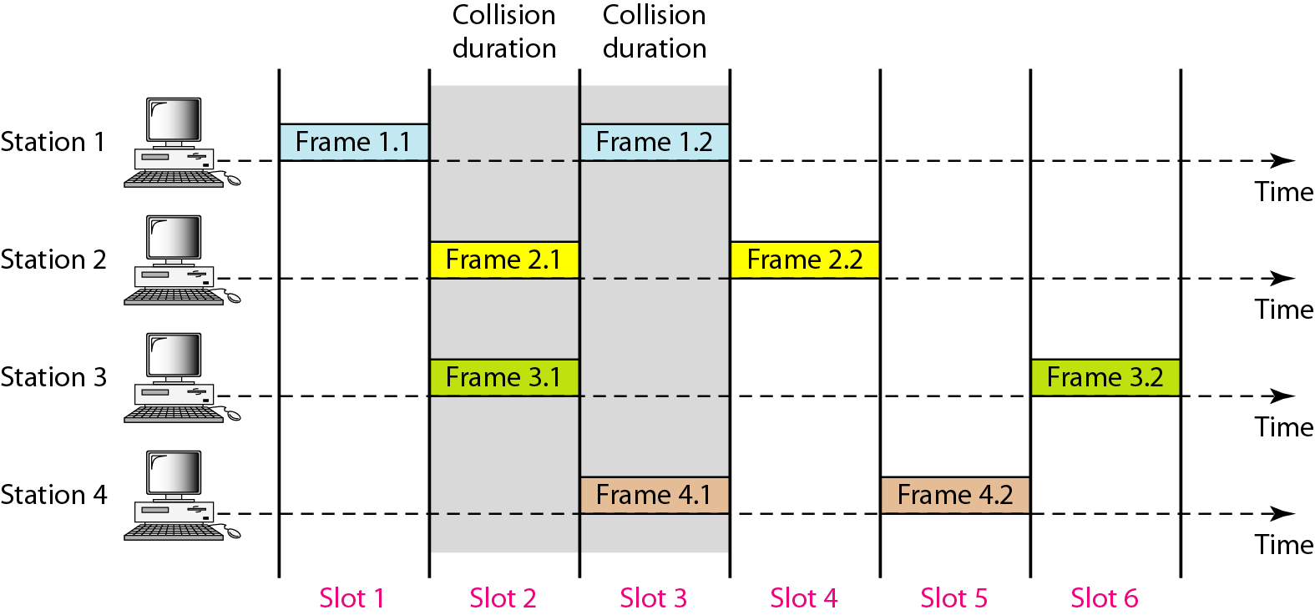
FRAMES IN SLOTTED ALOHA NETWORK

Slide 128
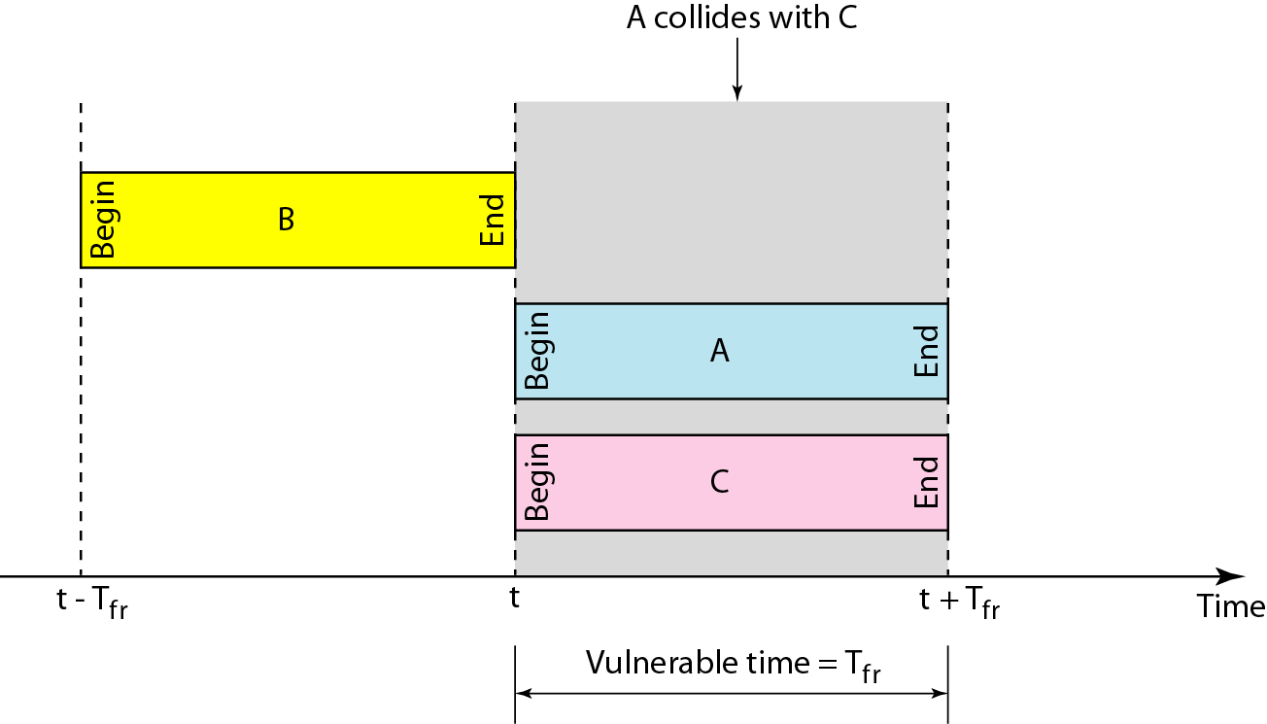
VULNERABLE TIME FOR SLOTTED ALOHA PROTOCOL

Slide 129
CSMA (Carrier Sense Multiple Access)
It is a carrier sense multiple access based on media access protocol to sense the traffic on a channel (idle or busy) before transmitting the data.
It means that if the channel is idle, the station can send data to the channel.
Otherwise, it must wait until the channel becomes idle.
Hence, it reduces the chances of a collision on a transmission medium.
CSMA can reduce the possibility of collision, but it cannot eliminate it.

Slide 130
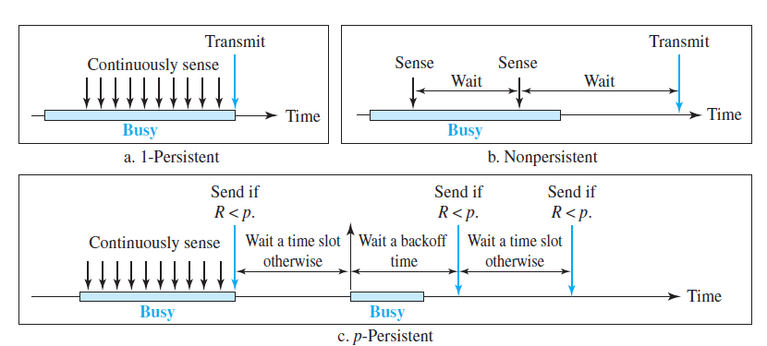
CSMA Access Modes
What should a station do if the channel is busy?
What should a station do if the channel is idle?
Three methods have been devised to answer these questions: the 1-persistent method, the nonpersistent method, and the p-persistent method.

Slide 131
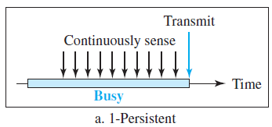
1- Persistent
In the 1-Persistent mode of CSMA that defines each node, first sense the shared channel and if the channel is idle, it immediately sends the data.
Else it must wait and keep track of the status of the channel to be idle and broadcast the frame unconditionally as soon as the channel is idle.

Slide 132
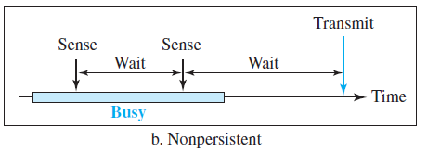
Non Persistent
It is the access mode of CSMA that defines before transmitting the data, each node must sense the channel, if the channel is inactive (idle), it immediately sends the data.
Otherwise, the station must wait for a random time (not continuously), and when the channel is found to be idle, it transmits the frames.

Slide 133
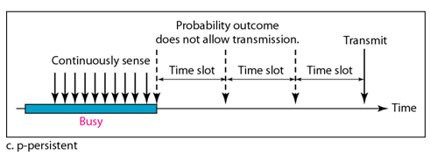
P- Persistent
It is the combination of 1-Persistent and Non-persistent modes.
The P-Persistent mode defines that each node senses the channel, and if the channel is inactive, it sends a frame with a P probability.
If the data is not transmitted, it waits for a random time and resumes the frame with the next time slot.

Slide 134

Flow diagram for three persistence methods

Slide 135
CSMA/CD (Carrier Sense Multiple Access/ Collision Detection)
It is a carrier sense multiple access/ collision detection network protocol to transmit data frames.
The CSMA/CD protocol works with a medium access control layer.
It first senses the shared channel before broadcasting the frames, and if the channel is idle, it transmits a frame to check whether the transmission was successful.
If the frame is successfully received, the station sends another frame.

Slide 136
CSMA/CD
If any collision is detected in the CSMA/CD, the station sends a jam/ stop signal to the shared channel to terminate data transmission.
After that, it waits for a random time before sending a frame to a channel.

Slide 137
Collision of the first bits in CSMA/CD
At time t1, station A has executed its persistence procedure and starts sending the bits of its frame.
At time t2, station C has not yet sensed the first bit sent by A.
Station C executes its persistence procedure and starts sending the bits in its frame, which propagate both to the left and to the right.
The collision occurs sometime after time t2.
Station C detects a collision at time t3 when it receives the first bit of A’s frame.
Station C immediately (or after a short time, but we assume immediately) aborts transmission.
Station A detects collision at time t4 when it receives the first bit of C’s frame; it also immediately aborts transmission.
Looking at the figure, we see that A transmits for the duration t4 − t1; C transmits for the duration t3 − t2.

Slide 138


Collision of the first bits in CSMA/CD

Slide 139

Flow diagram for the CSMA/CD

Slide 140
Carrier Sense Multiple Access with Collision Avoidance (CSMA/CA)
It is a CSMA/CA network protocol for carrier transmission of data frames.
It is a protocol that works with a medium access control layer.
When a data frame is sent to a channel, it receives an acknowledgment to check whether the channel is clear.
If the station receives only a single (own) acknowledgments, that means the data frame has been successfully transmitted to the receiver.

Slide 141
CSMA/CA
But if it gets two signals (its own and one more in which the collision of frames), a collision of the frame occurs in the shared channel.
Detects the collision of the frame when a sender receives an acknowledgment signal.
Collisions are avoided through the use of CSMA/CA’s three strategies: the interframe space, the contention window, and acknowledgments

Slide 142
CSMA/CA
Interframe space:
In this method, the station waits for the channel to become idle, and if it gets the channel is idle, it does not immediately send the data.
Instead of this, it waits for some time, and this time period is called the Interframe space or IFS.
However, the IFS time is often used to define the priority of the station.

Slide 143
CSMA/CA
Contention Window.
The contention window is an amount of time divided into slots.
A station that is ready to send chooses a random number of slots as its wait time.
The number of slots in the window changes according to the binary exponential backoff strategy.
This means that it is set to one slot the first time and then doubles each time the station cannot detect an idle channel after the IFS time.

Slide 144

CSMA/CA
The station needs to sense the channel after each time slot.
However, if the station finds the channel busy, it does not restart the process; it just stops the timer and restarts it when the channel is sensed as idle.
This gives priority to the station with the longest waiting time.

Slide 145
CSMA/CA
Acknowledgment.
With all these precautions, there still may be a collision resulting in destroyed data.
In addition, the data may be corrupted during the transmission.
The positive acknowledgment and the time-out timer can help guarantee that the receiver has received the frame.

Slide 146

Flow diagram for CSMA/CA

Slide 147
CONTROLLED ACCESS PROTOCOLS
In controlled access, the stations consults each other to find which station has right to send
Controlled access protocols grants permission to send only one node at a time, to avoid collision of frames on the shared medium.
So, these protocols also called as Collision free protocols
A station cannot send data unless it is authorized by the other stations

Slide 148
CONTROLLED ACCESS PROTOCOLS
There are three methods of controlled access protocol, namely
Reservation
Polling
Token passing

Slide 149
RESERVATION
In the reservation method, a station needs to make reservation before sending data
The timeline has two kinds of periods:
1. Reservation interval of fixed time length
2. Data transmission period of variable frames
In each interval, a reservation frame precedes the data frames sent in that interval

Slide 150
RESERVATION
If there are N stations in the network, there are exactly N reservation mini slots in the reservation frame.
Each mini slot belongs to a station. When a station needs to send a data frame, it makes a reservation in its own mini slot.
The stations that have made reservations can send their data frames after the reservation frame

Slide 151

RESERVATION
A situation with five stations and a five mini slot reservation frame

Slide 152
POLLING
Polling process is similar to the roll-call performed in class. Just like the teacher, a controller sends a message to each node in turn.
In this, one acts as a primary station(controller) and the others are secondary stations. All data exchanges must be made through the controller.
The message sent by the controller contains the address of the node being selected for granting access.
Although all nodes receive the message the addressed one responds to it and sends data if any. If there is no data, usually a “poll reject”(NAK) message is sent back.

Slide 153
POLLING
There are two functions done by the controlling station
1. Polling function
2. Selection function

Slide 154
Poll Function
Suppose there is a condition when the primary device wants to accept data from secondary devices, then in this condition, it generally asks from secondary devices if they want to transmit any data.
This process is known as the polling function.
The polling function is used by the primary device to ask for transmit the data from the secondary device.

Slide 155

POLLING FUNCTION
When the Primary device wants to get the data frame then it should ask (poll) each secondary device on that particular network if they want to transfer any data frame.
If the secondary device has any data that it need not to transfer to the primary device then it sends the data frame although it will transmit a negative acknowledgment (NAK)

Slide 156
POLLING FUNCTION
If there is a condition when the primary device receives a negative acknowledgment from one secondary device then it repeats this process with another secondary device in the same manner till it finds the secondary device that has some data to send.
Whenever the primary device gets a positive acknowledgment i.e. data frame from any secondary device, then after it, it reads the data frame and transmits a return acknowledgment (ACK).

Slide 157
SELECT FUNCTION
Suppose there is a condition when the primary device needs to send some data to secondary devices then they tell the secondary devices so that secondary devices prepare themselves to receive the data.
This process is known as the select function.
The primary device generally uses a select function when it wants to send some data to secondary devices.
As already mentioned above the primary device always has control over the link.

Slide 158
SELECT FUNCTION
Before transferring any data frame, there is the creation of a select (SEL) frame
And the primary device transmits this frame to the secondary device.
This SEL frame in its one field contains the address of the secondary device to which the primary device wants to send the data.
There is an alert from the primary device to the secondary device for the transmission of the upcoming data packet.
After this primary device waits for the acknowledgment(ACK) frame from the secondary device.

Slide 159
POLLING
Advantages:
Priorities can be assigned to ensure faster access from some secondary
Maximum and minimum access times and data rates on the channel are predictable and fixed
Disadvantage:
High dependence on the reliability of the controller

Slide 160
TOKEN PASSING
In token passing scheme, the stations are connected logically to each other in form of ring and access to stations is governed by tokens.
A token is a special bit pattern or a small message, which circulate from one station to the next in some predefined order.
In Token ring, token is passed from one station to another adjacent station in the ring whereas incase of Token bus, each station uses the bus to send the token to the next station in some predefined order.

Slide 161
TOKEN PASSING
In both cases, token represents permission to send. If a station has a frame queued for transmission when it receives the token, it can send that frame before it passes the token to the next station. If it has no queued frame, it passes the token simply.
After sending a frame, each station must wait for all N stations (including itself) to send the token to their neighbours and the other N – 1 stations to send a frame, if they have one.
There exists problems like duplication of token or token is lost or insertion of new station, removal of a station, which need be tackled for correct and reliable operation of this scheme.

Slide 162
TOKEN PASSING

Slide 163


Slide 164

Logical ring and physical topology in token-passing access method

Slide 165
COLLISION FREE PROTOCOLS
A Bit Map Protocol
This protocol is also called as Reservation Protocol
Token Passing
Binary Countdown

Slide 166
BINARY COUNTDOWN
The basic bit-map protocol or reservation protocol, and token passing protocols have a common issue: they introduce an overhead of 1 bit per station.
This overhead becomes a problem when dealing with networks that have thousands of stations.
In such large networks, the overhead can become significant and negatively impact the efficiency and scalability of the network.

Slide 167
BINARY COUNTDOWN
The "binary countdown" protocol is a more efficient approach for managing network overhead in large networks.
Instead of using a fixed 1-bit overhead per station, this protocol utilizes binary station addresses and a channel that combines transmissions.
Here's how it works:
Binary Station Addresses: Each station in the network is assigned a unique binary address. All addresses are of the same length, and they are expressed as binary bit strings. The high-order bit is sent first.

Slide 168
BINARY COUNTDOWN
The bits in each address position from different stations are BOOLEAN ORed together by the channel when they are sent at the same time.
This approach reduces overhead because, instead of requiring a dedicated bit for each station, it allows multiple station addresses to be sent simultaneously, and their bits are combined.

Slide 169
BINARY COUNTDOWN
In the "binary countdown" protocol, to prevent conflicts, stations follow an arbitration rule: if a station observes that a high-order bit, which is 0 in its own address, has been set to 1, it gives up its contention for the channel.
For example, if stations 0010, 0100, 1001, and 1010 are competing for the channel, during the first bit time, they transmit 0, 0, 1, and 1, respectively. These bits are ORed together to produce a 1. Stations 0010 and 0100, seeing the 1, recognize that a station with a higher address is also contending, so they abandon their contention for the current round. Stations 1001 and 1010 continue.

Slide 170
BINARY COUNTDOWN
In the next bit, a 0 is transmitted, and both stations (1001 and 1010) continue. The following bit is 1, and at this point, station 1001 gives up. The station with the highest address, in this case, 1010, becomes the winner. After winning the competition, it can transmit a data frame. Afterward, a new bidding cycle begins.
This protocol prioritizes stations with higher addresses over those with lower addresses, which can have advantages or disadvantages depending on the specific network context.

Slide 171

BINARY COUNTDOWN

Slide 172

DATA LINK LAYER SWITCHING
Many organizations have multiple LANs and wish to connect them.
This can be achieved by connections are made with the devices called Bridges/Switches
The Ethernet switches are a modern name for bridges; they provide functionality that goes beyond classic Ethernet and Ethernet hubs to make it easy to join multiple LANs into a larger and faster network.
We shall use the terms ‘‘bridge’’ and ‘‘switch’’ interchangeably.

Slide 173

CONNECTING DEVICES
Three categories of connecting devices

Slide 174
Switching
When a user accesses the internet or another computer network outside their immediate location, messages are sent through the network of transmission media.
This technique of transferring the information from one computer network to another network is known as switching.
Switching in a computer network is achieved by using switches. A switch is a small hardware device which is used to join multiple computers together with one local area network (LAN).
Network switches operate at layer 2 (Data link layer) in the OSI model.
Switching is transparent to the user and does not require any configuration in the home network.

Slide 175
Switching
Switches are used to forward the packets based on MAC addresses.
A Switch is used to transfer the data only to the device that has been addressed. It verifies the destination address to route the packet appropriately.
It is operated in full duplex mode.
Packet collision is minimum as it directly communicates between source and destination.
It does not broadcast the message as it works with limited bandwidth.

Slide 176
LINK-LAYER SWITCHES
Filtering
One may ask what the difference in functionality is between a link-layer switch and a hub.
A link-layer switch has filtering capability.
It can check the destination address of a frame and can decide from which outgoing port the frame should be sent.
A link-layer switch has a table used in filtering decisions.

Slide 177

LINK-LAYER SWITCHES
Let us see an example. In Figure have a LAN with four stations that are connected to a link-layer switch.
If a frame destined for station 71:2B:13:45:61:42 arrives at port 1, the link-layer switch consults its table to find the departing port.
According to its table, frames for 71:2B:13:45:61:42 should be sent out only through port 2; therefore, there is no need for forwarding the frame through other ports.
A link-layer switch does not change the link-layer (MAC) addresses in a frame.

Slide 178
LINK-LAYER SWITCHES
Transparent Switches
A transparent switch is a switch in which the stations are completely unaware of the switch’s existence.
If a switch is added or deleted from the system, reconfiguration of the stations is unnecessary.
According to the IEEE 802.1d specification, a system equipped with transparent switches must meet following criterias:
Frames must be forwarded from one station to another.
The forwarding table is automatically made by learning frame movements in the network.

Slide 179
LINK-LAYER SWITCHES
Learning
To make a table dynamic, a switch that gradually learns from the frames’ movements.
To do this, the switch inspects both the destination and the source addresses in each frame that passes through the switch.
The destination address is used for the forwarding decision (table lookup); the source address is used for adding entries to the table and for updating purposes.

Slide 180






LINK-LAYER SWITCHES
Gradual building of table

Slide 181
LINK-LAYER SWITCHES
Advantages of Switches
A link-layer switch has several advantages over a hub.
Collision Elimination
A link-layer switch eliminates the collision.
This means increasing the average bandwidth available to a host in the network.
In a switched LAN, there is no need for carrier sensing and collision detection; each host can transmit at any time.

Slide 182
LINK-LAYER SWITCHES
Connecting Heterogenous Devices
A link-layer switch can connect devices that use different protocols at the physical layer (data rates) and different transmission media.
As long as the format of the frame at the data-link layer does not change, a switch can receive a frame from a device that uses twisted-pair cable and sends data at 10 Mbps and deliver the frame to another device that uses fiber-optic cable and can receive data at 100 Mbps.

Slide 183
SWITCHING TECHNIQUES
In large networks, there can be multiple paths from sender to receiver.
The switching technique will decide the best route for data transmission.
Switching technique is used to connect the systems for making one-to-one communication.
What is switching?
Switching is a process to forward packet coming from one port to a port towards the destination.
A communication system may include number of switches and nodes.

Slide 184
SWITCHING TECHNIQUES
Switching can be divided into two major categories:
Connection less
There is no need to establish connection between source and destination
Connection Oriented
Must establish connection (path) between source and destination

Slide 185

SWITCHING TECHNIQUES

Slide 186
Circuit Switching
Circuit switching is a switching technique that establishes a dedicated path between sender and receiver.
In the Circuit Switching Technique, once the connection is established then the dedicated path will remain to exist until the connection is terminated.
Circuit switching in a network operates in a similar way as the telephone works.
A complete end-to-end path must exist before the communication takes place.
Circuit switching is used in public telephone network. It is used for voice transmission.
Fixed data can be transferred at a time in circuit switching technology.

Slide 187

Circuit Switching
Communication through circuit switching has 3 phases:
Circuit establishment
Data transfer
Circuit Disconnect

Slide 188
Circuit Switching
Advantages Of Circuit Switching:
In the case of Circuit Switching technique, the communication channel is dedicated.
It has fixed bandwidth.
Disadvantages Of Circuit Switching:
Once the dedicated path is established, the only delay occurs in the speed of data transmission.
It is more expensive than other switching techniques as a dedicated path is required for each connection.
It is inefficient to use because once the path is established and no data is transferred, then the capacity of the path is wasted.
In this case, the connection is dedicated therefore no other data can be transferred even if the channel is free.

Slide 189
Message Switching
Message Switching is a switching technique in which a message is transferred as a complete unit and routed through intermediate nodes at which it is stored and forwarded.
In Message Switching technique, there is no establishment of a dedicated path between the sender and receiver.
The destination address is appended to the message. Message Switching provides a dynamic routing as the message is routed through the intermediate nodes based on the information available in the message.

Slide 190

Message Switching
Message switches are programmed in such a way so that they can provide the most efficient routes.
Each and every node stores the entire message and then forward it to the next node. This type of network is known as store and forward network.
Message switching treats each message as an independent entity.

Slide 191
Message Switching
Advantages Of Message Switching
Data channels are shared among the communicating devices that improve the efficiency of using available bandwidth.
Traffic congestion can be reduced because the message is temporarily stored in the nodes.
Message priority can be used to manage the network.
The size of the message which is sent over the network can be varied. Therefore, it supports the data of unlimited size.
Disadvantages Of Message Switching
The message switches must be equipped with sufficient storage to enable them to store the messages until the message is forwarded.
The Long delay can occur due to the storing and forwarding facility provided by the message switching technique.

Slide 192
Packet Switching
The packet switching is a switching technique in which the message is sent in one go, but it is divided into smaller pieces, and they are sent individually.
The message splits into smaller pieces known as packets and packets are given a unique number to identify their order at the receiving end.
Every packet contains some information in its headers such as source address, destination address and sequence number.
Packets will travel across the network, taking the shortest path as possible.

Slide 193

Packet Switching
All the packets are reassembled at the receiving end in correct order.
If any packet is missing or corrupted, then the message will be sent to resend the message.
If the correct order of the packets is reached, then the acknowledgment message will be sent.

Slide 194
Packet Switching
Advantages Of Packet Switching:
Cost-effective: In packet switching technique, switching devices do not require massive secondary storage to store the packets, so cost is minimized to some extent. Therefore, we can say that the packet switching technique is a cost-effective technique.
Reliable: If any node is busy, then the packets can be rerouted. This ensures that the Packet Switching technique provides reliable communication.
Efficient: Packet Switching is an efficient technique. It does not require any established path prior to the transmission, and many users can use the same communication channel simultaneously, hence makes use of available bandwidth very efficiently.

Slide 195
Packet Switching
Disadvantages Of Packet Switching:
Packet Switching technique cannot be implemented in those applications that require low delay and high-quality services.
The protocols used in a packet switching technique are very complex and requires high implementation cost.
If the network is overloaded or corrupted, then it requires retransmission of lost packets. It can also lead to the loss of critical information if errors are nor recovered.

Slide 196
USES OF BRIDGES
The following are the some common situations in which bridges are used
Multiple LANs in a Single Organization:
Universities and corporate departments often have their own LANs for various purposes.
Different departments may establish separate LANs without considering other departments' needs.
Eventually, the need for interaction between these LANs arises, requiring bridges to connect them.
Multiple LANs result from the autonomy of LAN owners.

Slide 197
USES OF BRIDGES
Geographical Distribution of the Organization:
Organizations with buildings spread over significant distances may opt for separate LANs in each building.
Bridges and long-distance fiber optic links are used to connect these LANs.
Running cables to a single central switch can be impractical or costly.
Load and Scale Considerations:
Large universities and companies may have thousands of workstations.
This scale makes it impractical to connect all workstations to a single LAN.
Bridges are used to split the logically single LAN into separate LANs to manage the load.

Slide 198
LEARNING BRIDGES
The algorithm used by the bridges is backward learning.
As mentioned discussed in previous lectures topic of learning switches the bridges operate in promiscuous mode, so they see every frame sent on any of their ports.
By looking at the source addresses, they can tell which machines are accessible on which ports.

Slide 199

SPANNING TREE BRIDGES
To increase reliability, redundant links can be used between bridges.
In the example of fig shown below, there are two links in parallel between a pair of bridges.
This design ensures that if one link is cut, the network will not be partitioned into two sets of computers that cannot talk to each other.

Slide 200
SPANNING TREE BRIDGES
This redundancy introduces some additional problems because it creates loops in the topology.
One way to understand these problems is by examining how a frame sent by station A to an address it hasn't communicated with before is managed, as illustrated in Figure above.
Each bridge follows the normal rule for handling unknown destinations, which is to flood the frame.

Slide 201
SPANNING TREE BRIDGES
Examining the figure to understand the problem of looping
Call the frame from A that reaches bridge B1 frame F0.
The bridge B1 sends copies of this frame out all of its other ports. (only consider the bridge ports that connect B1 to B2)
Since there are two links from B1 to B2, two copies of the frame will reach B2 as F1 and F2.
Shortly thereafter, bridge B2 receives these frames.

Slide 202
SPANNING TREE BRIDGES
However, Bridge B2 does not (and cannot) know that they are copies of the same frame, rather than two different frames sent one after the other.
So bridge B2 takes F1 and sends copies of it out all the other ports, and it also takes F2 and sends copies of it out all the other ports.
This produces frames F3 and F4 that are sent along the two links back to B1.
Bridge B1 then sees two new frames with unknown destinations and copies them again.
This cycle goes on forever. The procedure enters into a loop.

Slide 203
SPANNING TREE BRIDGES
The solution to this challenge is for the bridges to talk to one another and create a spanning tree that links every bridge.
Spanning Tree Bridges, or Spanning Tree Protocol (STP), are network devices and protocols that help prevent loops in Ethernet networks.
They work by creating a logical tree-like structure that determines the best path for data to travel, eliminating redundancy and ensuring reliable network operation.

Slide 204

SPANNING TREE BRIDGES

Slide 205
SPANNING TREE BRIDGES
he algorithm for constructing the spanning tree was invented by Radia Perlman.
Her job was to solve the problem of joining LANs without loops.
The spanning tree algorithm was then standardized as IEEE 802.1D

Slide 206

NETWORK CONNECTING DEVICES
A LAN (Local Area Network) or subnetwork are connected with one another through internet by using a different type of connecting device, and these connecting devices working a different way as they are different from each other and it operates a different layer of the OSI model as it required.
There are many connecting devices such as:
Repeater
Hub
Bridges
Routers
Gateways

Slide 207
NETWORK CONNECTING DEVICES
Repeaters:
Repeaters are simple devices used to extend the range of a network by amplifying and retransmitting signals.
They are used in analog and older Ethernet networks to boost signal strength.
Hubs:
Hubs are basic networking devices that connect multiple network devices in a physical star topology.
They broadcast data to all connected devices, making them inefficient for large networks.
Bridges:
Bridges are devices that segment and filter network traffic to reduce collision domains, improving network performance.
They operate at the data link layer and use MAC addresses for filtering.

Slide 208
NETWORK CONNECTING DEVICES
Switches:
Switches are advanced versions of bridges that operate at the data link layer.
They use MAC addresses to efficiently forward data only to the specific device it's intended for, reducing network congestion.
Routers:
Routers are network devices that operate at the network layer (Layer 3) and connect different networks.
They determine the best path for data to travel between networks, making routing decisions based on IP addresses.
Gateways:
Gateways are devices or software that act as intermediaries between different networks using different protocols.
They translate data between different network architectures and allow them to communicate with each other.

Slide 209
WIRELESS LANS
Wireless LAN stands for Wireless Local Area Network.
It is also called LAWN (Local Area Wireless Network).
WLAN is one in which a mobile user can connect to a Local Area Network (LAN) through a wireless connection.
Wireless LANs are increasingly popular, and homes, offices, cafes, libraries, airports, zoos, and other public places are being outfitted with them to connect computers, PDAs, and smart phones to the Internet.
The main wireless LAN standard is IEEE 802.11.

Slide 210

The 802.11 Architecture and Protocol Stack
802.11 networks can be used in two modes.
Infrastructure mode
Ad hoc network or Ad hoc mode

Slide 211
The 802.11 Architecture and Protocol Stack
Infrastructure mode
In this mode each client is associated with an AP (Access Point) that is in turn connected to the other network.
The client sends and receives its packets via the AP.
Several access points may be connected together, typically by a wired network called a distribution system, to form an extended 802.11 network.
In this case, clients can send frames to other clients via their APs.

Slide 212
The 802.11 Architecture and Protocol Stack
Ad hoc network
This mode is a collection of computers that are associated so that they can directly send frames to each other.
There is no access point.
Ad hoc networks are not very popular.

Slide 213

WIRELESS LANS
802.11 Protocol Stack Shown in below figure

Slide 214
WIRELESS LANS
The data link layer in all the 802 protocols is split into two or more sublayers.
In 802.11, the MAC (Medium Access Control) sublayer determines how the channel is allocated, that is, who gets to transmit next.
Above it is the LLC (Logical Link Control) sublayer, differences between the different 802 variants and make them indistinguishable as far as the network layer is concerned.

Slide 215
WIRELESS LANS: The 802.11 Physical Layer
Each of the transmission techniques makes it possible to send a MAC frame over the air from one station to another.
They differ, in the technology used and speeds achievable.
All of the 802.11 techniques use short-range radios to transmit signals in either the 2.4-GHz or the 5-GHz ISM (Industrial, Scientific, Medical) frequency bands.
These bands have the advantage of being unlicensed and hence freely available to any transmitter.

Slide 216
WIRELESS LANS: The 802.11 Physical Layer
The 2.4-GHz band tends to be more crowded than the 5-GHz band, so 5 GHz can be better for some applications even though it has shorter range due to the higher frequency.
All of the transmission methods define multiple rates and that different rates can be used depending on the current conditions.
If the wireless signal is weak, a low rate can be used. If the signal is clear, the highest rate can be used. This adjustment is called rate adaptation.

Slide 217
WIRELESS LANS: The 802.11 Physical Layer
The different transmission methods are
802.11b
It is a spread-spectrum method that supports rates of 1, 2, 5.5, and 11 Mbps
In practice the operating rate is nearly always 11 Mbps.
802.11a
It supports rates up to 54 Mbps in the 5-GHz ISM band.
It is based on OFDM (Orthogonal Frequency Division Multiplexing) because OFDM uses the spectrum efficiently and resists wireless signal degradations such as multipath.
802.11a can run at eight different rates, ranging from 6 to 54 Mbps. These rates are significantly faster than 802.11b rates

Slide 218
WIRELESS LANS: The 802.11 Physical Layer
802.11b has a range that is about seven times greater than that of 802.11a, which is more important in many situations.
802.11g
It copies the OFDM modulation methods of 802.11a but operates in the narrow 2.4-GHz ISM band along with 802.11b.
It offers the same rates as 802.11a (6 to 54 Mbps) plus of course compatibility with any 802.11b devices.
All of these different choices can be confusing for customers, so it is common for products to support 802.11a/b/g in a single NIC.

Slide 219
WIRELESS LANS: The 802.11 Physical Layer
802.11n
The IEEE committee began work on a high-throughput physical layer called 802.11n
The goal is to increase the throughput of 802.11 wireless LANs up to 100Mbps.
802.11n uses up to four antennas to transmit up to four streams of information at the same time.
The signals of the streams interfere at the receiver, but they can be separated using MIMO (Multiple Input Multiple Output) communications techniques.
The use of multiple antennas gives a large speed boost, or better range and reliability instead.

Slide 220

THE 802.11 MAC SUBLAYER PROTOCOL
IEEE 802.11 defines two MAC sublayers:
Distributed Coordination Function (DCF)
Point Coordination Function (PCF)

Slide 221
THE 802.11 MAC SUBLAYER PROTOCOL
Distributed Coordination Function
One of the two protocols defined by IEEE at the MAC sublayer is called the distributed coordination function (DCF).
DCF uses CSMA/CA as the access method
Frame Exchange Time Line figure shows the exchange of data and control frames in time.

Slide 222

THE 802.11 MAC SUBLAYER PROTOCOL
1. Before sending a frame, the source station senses the medium by checking the energy level at the carrier frequency.
a. The channel uses a persistence strategy with back-off until the channel is idle.
b. After the station is found to be idle, the station waits for a period of time called the distributed interframe space (DIFS); then the station sends a control frame called the request to send (RTS).

Slide 223
THE 802.11 MAC SUBLAYER PROTOCOL
2. After receiving the RTS and waiting a period of time called the short interframe space (SIFS), the destination station sends a control frame, called the clear to send (CTS), to the source station. This control frame indicates that the destination station is ready to receive data.
3. The source station sends data after waiting an amount of time equal to SIFS.
4. The destination station, after waiting an amount of time equal to SIFS, sends an acknowledgment to show that the frame has been received.

Slide 224

THE 802.11 MAC SUBLAYER PROTOCOL
802.11 CSMA/CA flowchart

Slide 225
THE 802.11 MAC SUBLAYER PROTOCOL
Network Allocation Vector
When a station sends an RTS frame, it includes the duration of time that it needs to occupy the channel.
The stations that are affected by this transmission create a timer called a network allocation vector (NAV) that shows how much time must pass before these stations are allowed to check the channel for idleness.
Each time a station accesses the system and sends an RTS frame, other stations start their NAV.
In other words, each station, before sensing the physical medium to see if it is idle, first checks its NAV to see if it has expired.

Slide 226
THE 802.11 MAC SUBLAYER PROTOCOL
Point Coordination Function (PCF)
It is an optional access method that can be implemented in an infrastructure network (not in an ad hoc network).
It is implemented on top of the DCF and is used mostly for time-sensitive transmission.
PCF has a centralized, contention-free polling access method
The AP performs polling for stations that are capable of being polled.
The stations are polled one after another, sending any data they have to the AP.

Slide 227
THE 802.11 MAC SUBLAYER PROTOCOL
To give priority to PCF over DCF, another interframe space, PIFS, has been defined.
PIFS (PCF IFS) is shorter than DIFS.
This means that if, at the same time, a station wants to use only DCF and an AP wants to use PCF, the AP has priority.
Due to the priority of PCF over DCF, stations that only use DCF may not gain access to the medium.

Slide 228
THE 802.11 MAC SUBLAYER PROTOCOL
To prevent this, a repetition interval has been designed to cover both contention-free PCF and contention-based DCF traffic.
The repetition interval, which is repeated continuously, starts with a special control frame, called a beacon frame.
When the stations hear the beacon frame, they start their NAV for the duration of the contention-free period of the repetition interval

Slide 229

THE 802.11 MAC SUBLAYER PROTOCOL

Slide 230
THE 802.11 MAC SUBLAYER PROTOCOL
During the repetition interval, the PC (point controller)/Polled Station/ Access Point can send a poll frame, receive data, send an ACK, receive an ACK, or do any combination of these (802.11 uses piggybacking).
At the end of the contention-free period, the PC sends a CF end (contention-free end) frame to allow the contention-based stations to use the medium.

Slide 231
THE 802.11 MAC SUBLAYER PROTOCOL
Fragmentation
The wireless environment is very noisy, so frames are often corrupted.
A corrupt frame has to be retransmitted.
The protocol, therefore, recommends fragmentation—the division of a large frame into smaller ones.
It is more efficient to resend a small frame than a large one.

Slide 232

THE 802.11 MAC SUBLAYER PROTOCOL: Frame format
The MAC layer frame consists of nine fields, as shown in Figure

Slide 233

THE 802.11 MAC SUBLAYER PROTOCOL: Frame format
Frame control (FC). The FC field is 2 bytes long and defines the type of frame and some control information. Table describes the subfields.
Field | Explanation
Version | Current version is 0
Type | Type of information: management (00), control (01), or data (10)
Subtype | Subtype of each type
To DS | To distributed system (0 or 1) (To Station or Access Point)
From DS | To distributed system (0 or 1) (From Station or Access Point)
More frag | When set to 1, means more fragments
Retry | When set to 1, means retransmitted frame
Pwr mgt | When set to 1, means station is in power management mode
More data | When set to 1, means station has more data to send
WEP | Wired equivalent privacy (encryption implemented)
Rsvd | Reserved

Slide 234

THE 802.11 MAC SUBLAYER PROTOCOL: Frame format
D. This field defines the duration of the transmission that is used to set the value of NAV.
Addresses. There are four address fields, each 6 bytes long. The meaning of each address field depends on the value of the To DS and From DS subfields
Notes:
basic service set (BSS)

Slide 235

THE 802.11 MAC SUBLAYER PROTOCOL: Frame format
Notes:
basic service set (BSS)

Slide 236
THE 802.11 MAC SUBLAYER PROTOCOL: Frame format
Sequence control. This field, often called the SC field, defines a 16-bit value.
The first four bits define the fragment number;
The last 12 bits define the sequence number, which is the same in all fragments.
Frame body. This field, which can be between 0 and 2312 bytes, contains information based on the type and the subtype defined in the FC field.
FCS. The FCS field is 4 bytes long and contains a CRC-32 error-detection sequence.

Slide 237

THE 802.11 MAC SUBLAYER PROTOCOL: Frame format
Frame Types
A wireless LAN defined by IEEE 802.11 has three categories of frames: management frames, control frames, and data frames.
Management Frames
Management frames are used for the initial communication between stations and access points.
Control Frames
Control frames are used for accessing the channel and acknowledging frames.
Data Frames
Data frames are used for carrying data and control information.

Slide 238


Slide 240


